Slide 1
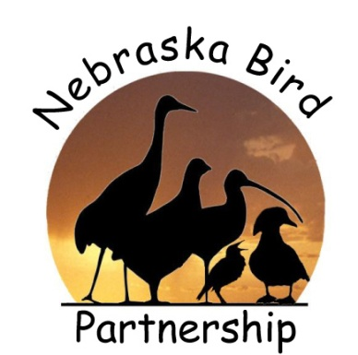

Ten things
YOU
can should do to help birds.

Slide 2
Ten things YOU can should do to help birds.
#10: Donate to a conservation fund
Audubon, Nebraska Wildlife Conservation Fund (Wildlife Check-off), The Nature Conservancy... There are numerous organizations dedicated to habitat and bird conservation.

Slide 3
Ten things YOU can should do to help birds.
#9: Prevent Window Strikes
Move feeders closer/farther from
windows.
- Stickers or silhouettes on windows.
- CD on a string or strips of ribbon.
- Screens or netting over windows.

Slide 4
Ten things YOU can should do to help birds.
#8: Keep cats indoors
Cats are the #1 killer of songbirds!
Plus, it is safer for cats indoors (diseases, cars,... Owls!)
Even well-fed cats will kill birds.

Slide 5
Ten things YOU can should do to help birds.
#7: Eliminate Pesticides
Some pesticides can have a direct impact on birds (think DDT).
But, mainly, pesticides have a major impact on a birds food – insects.
Kills insects so they are not available, or the pesticide on the insects builds-up in the birds causing major health issues.

Slide 6
Ten things YOU can should do to help birds.
#6: Landscape for Birds
Birds need a wide variety of plants... Berry producers, seed producers, shelter providers, nest material providers, etc.
Arrangement is vital.

Slide 7
Ten things YOU can should do to help birds.
#6: Landscape for Birds
Berry Producers:
Mulberry
Gooseberry
Hawthorn
Wild Grapes
Wild Strawberries
Plums
Elderberries
Buffalo berries
PawPaw
Eastern Cedar

Slide 8
Ten things YOU can should do to help birds.
#6: Landscape for Birds
Nut Producers:
Black Walnut
Hackberry
Shagbark Hickory
Oak – white, bur, red
Hazelnut

Slide 9
Ten things YOU can should do to help birds.
#6: Landscape for Birds
Seed Producers:
Thistle
Black-eyed Susan
Goldenrods
Sunflowers
Aster
Coneflowers
Native Grasses
Pinetrees

Slide 10
Ten things YOU can should do to help birds.
#6: Landscape for Birds
Shelter Providers:
- Evergreens... Pine, fir, spruce
- Cedar
- Ground nesting cover... Tallgrasses, etc.
- Dead trees
- Brush Piles

Slide 11
Ten things YOU can should do to help birds.
#6: Landscape for Birds
Nesting Material Providers:
Milkweed
Cottonwood
Grasses... Long grasses and grass clippings
Mud (provide a mud puddle)
Small twigs
You! ... String, fabric strips, dog hair, etc.

Slide 12
Ten things YOU can should do to help birds.
#5: Provide bird feeders
Lots of kinds of food – thistle, corn, sunflower, safflower, millet, etc.
Lots of kinds of feeders – ground, tube, platform, hopper, suet, etc.
Keep full – especially in winter!

Slide 13
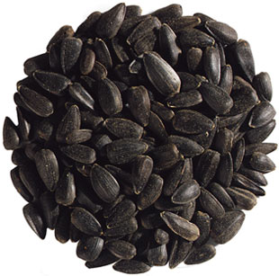
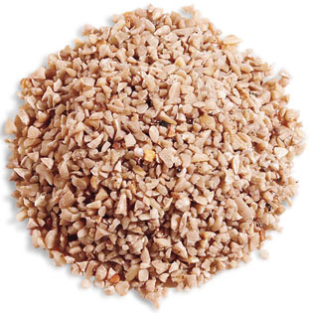
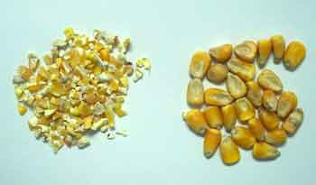
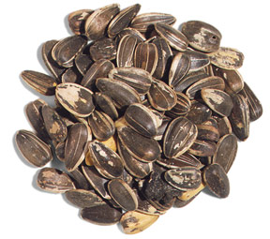
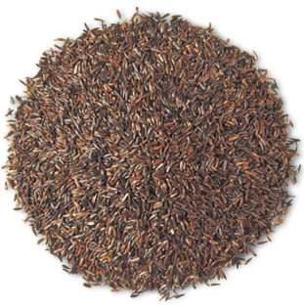
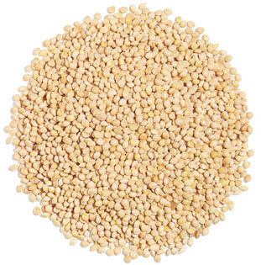
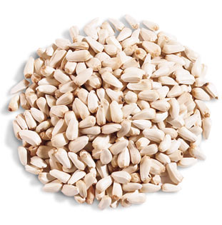
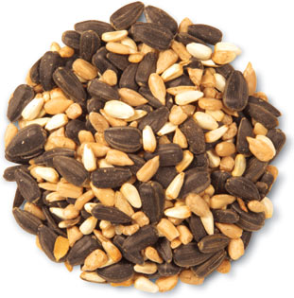
Ten things YOU can should do to help birds.
#5: Provide bird feeders
Lots of kinds of food:

Slide 14
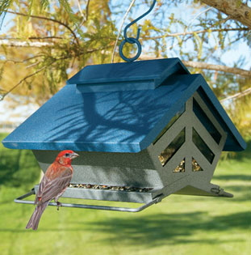
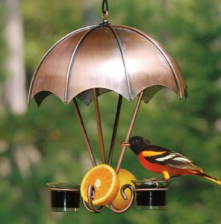
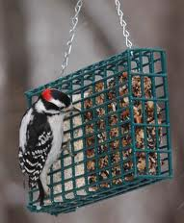
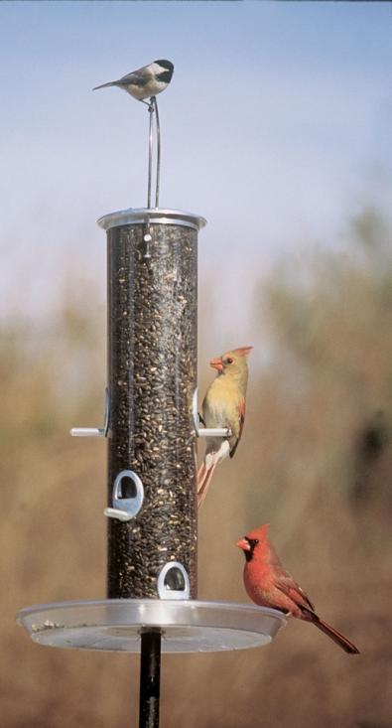
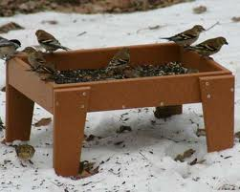
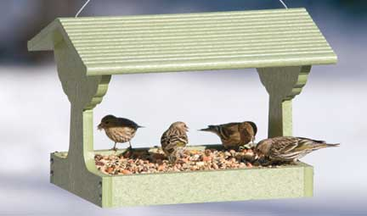
Ten things YOU can should do to help birds.
#5: Provide bird feeders
Lots of kinds of feeders:

Slide 15
Ten things YOU can should do to help birds.
#4: Provide Water
Even more than food, water is critical for birds. It keep birds hydrated (temperature regulation). Water also helps keep birds clean (free of mites, diseases, etc).
Water is vital year round, but more so in winter.

Slide 16
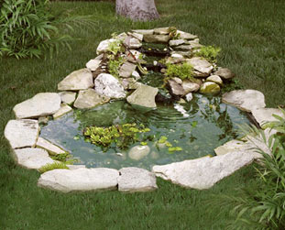
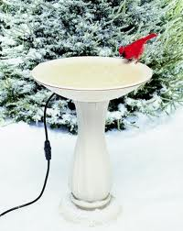
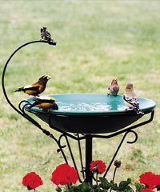
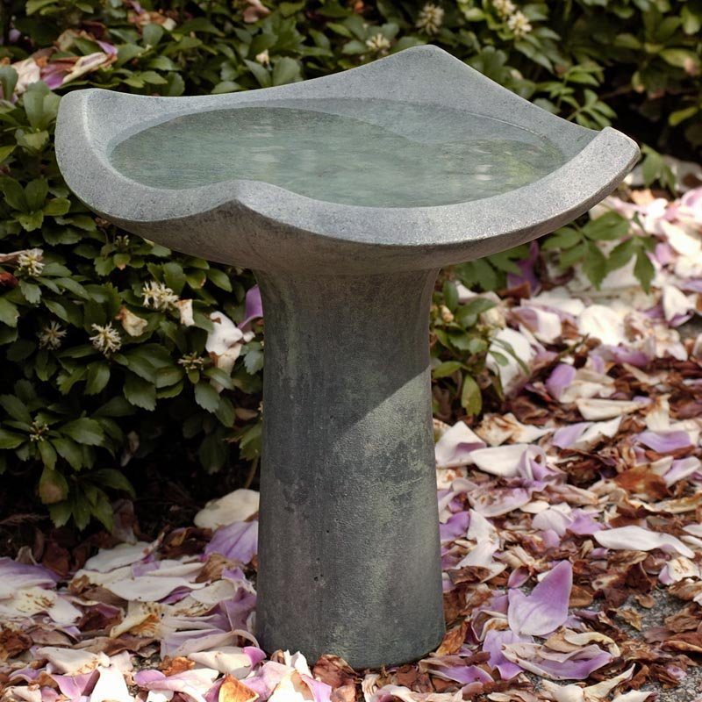
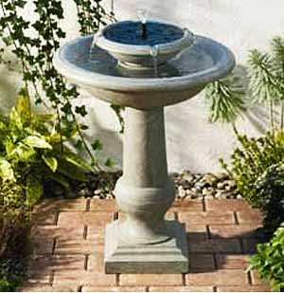
Ten things YOU can should do to help birds.
#4: Provide Water

Slide 17
Ten things YOU can should do to help birds.
#3: Keep Feeders and Water CLEAN!
You do not want to eat off a dirty plate... Neither do birds!
Clean feeders and water sources help to keep birds healthy. (And, it helps your seed stay fresh longer).

Slide 18
Ten things YOU can should do to help birds.
#2: Proper placement of feeders and water
Most birds prefer the drive thru... Not a sit down meal!??
Bushes, trees, evergreens all provide safe shelters.

Slide 19
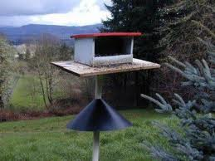
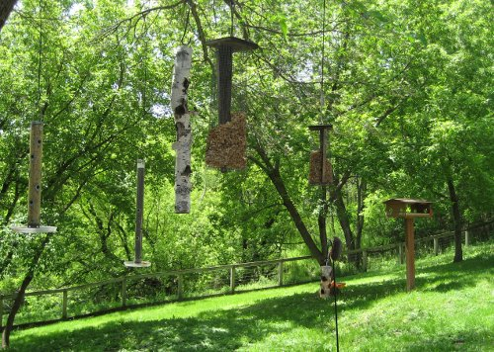
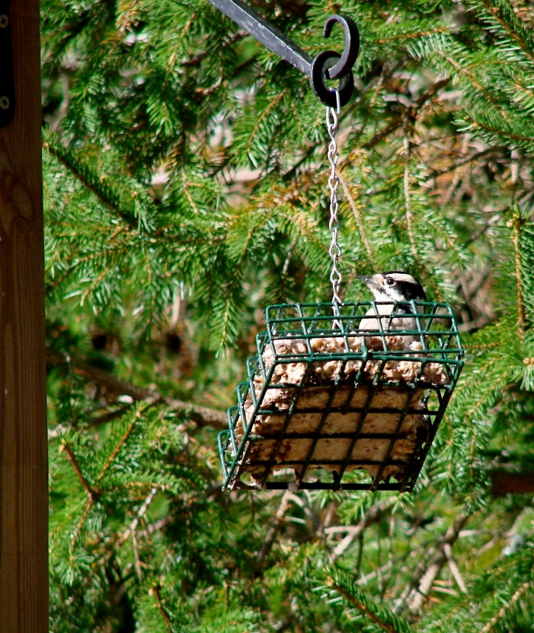
Ten things YOU can should do to help birds.

Slide 20
Ten things YOU can should do to help birds.
#1: Teach someone how to go bird watching!
For in the end, we will conserve only what we love, we will love only what we understand, and we will understand only what we are taught.

Slide 21
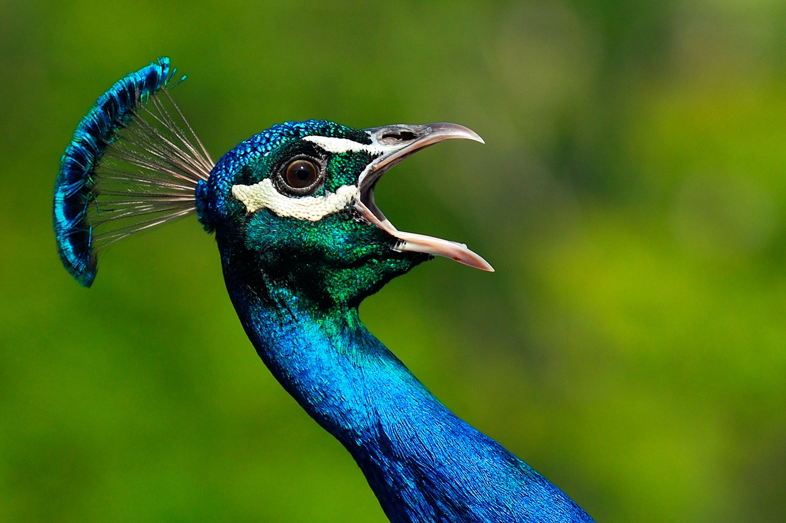
Ten things YOU can should do to help birds.
Questions?

