Slide 1
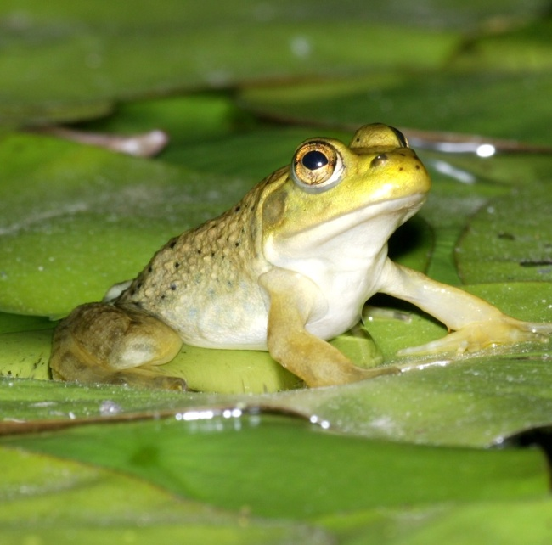
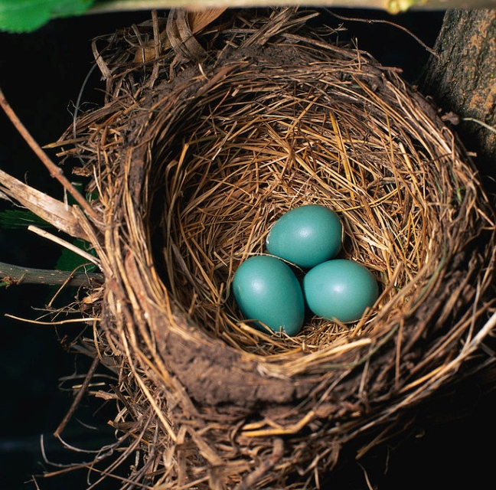
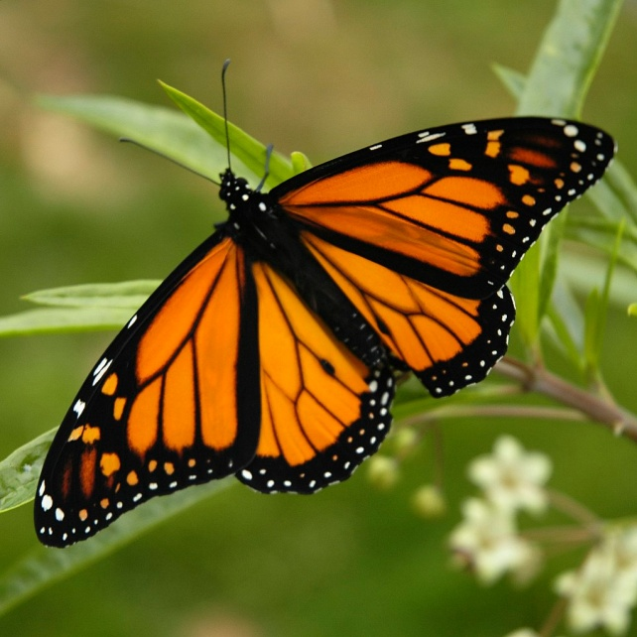
Life Cycles
Lindsay Rogers
Nebraska Game & Parks Commission

Slide 2
All living things have a life cycle…
Insects
Amphibians
Birds
Mammals
Plants

Slide 3
Insect Life Cycles
Insects go through one of two forms of metamorphosis:
Complete Metamorphosis
Incomplete Metamorphosis

Slide 4
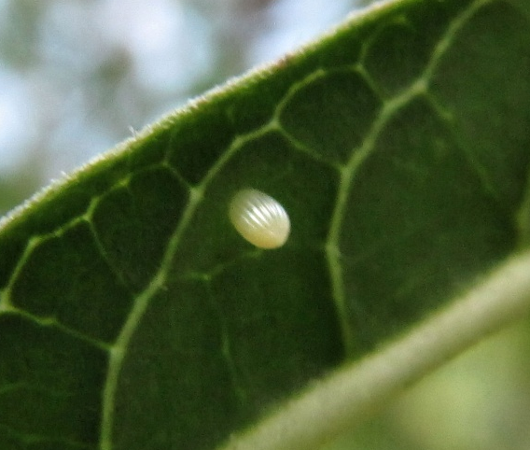
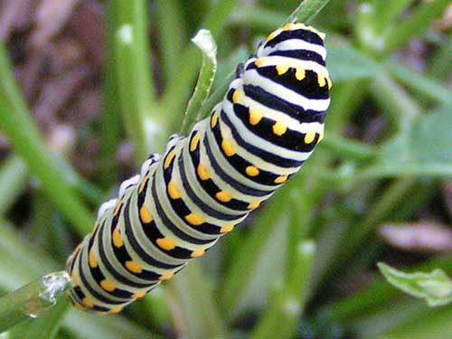
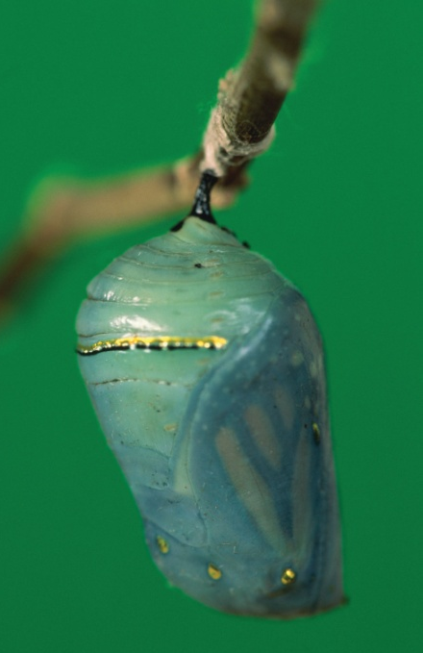

Insect Life Cycles: Complete Metamorphosis
1. Egg
2. Larva
3. Pupa
4. Adult
2
1
3
4
Notes:
Complete Metamorphosis
About 88% of all insects go through complete metamorphosis. Complete metamorphosis has 4 stages:
Egg - A female insects lays eggs.
Larva - Larvae hatch from the eggs. They do not look like adult insects. They usually have a worm-like shape. Caterpillers, maggots, and grubs are all just the larval stages of insects. Larvae molt their skin several times and they grow slightly larger.
Pupa - Larvae make cocoons around themselves. Larvae don't eat while they're inside their cocoons. Their bodies develop into an adult shape with wings, legs, internal organs, etc. This change takes anywhere from 4 days to many months.
Adult - Inside the cocoon, the larvae change into adults. After a period of time, the adult breaks out of the cocoon.

Slide 5
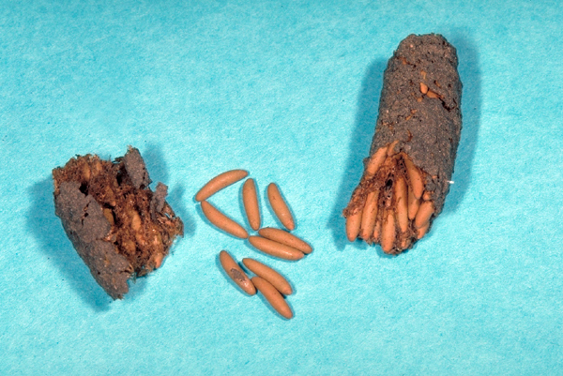
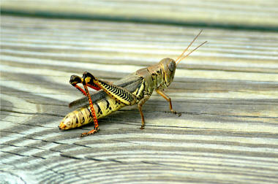
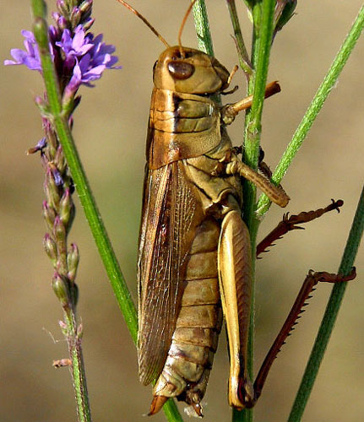
Insect Life Cycles: Incomplete Metamorphosis
Egg
Nymph
Adult
Note: Most grasshoppers go
through 5 instars or nymphs.
1
2
3
Notes:
Incomplete Metamorphosis
About 12% of all insects go through incomplete metamorphosis. Incomplete metamorphosis has 3 stages.
Egg - A female insect lays eggs. These eggs are often covered by an egg case which protects the eggs and holds them together.
Nymph - The eggs hatch into nymphs. Nymphs looks like small adults, but usually don't have wings. Insect nymphs eat the same food that the adult insect eats. Nymphs shed or molt their exoskeletons (outer casings made up of a hard substance called chitin) and replace them with larger ones several times as they grow. Most nymphs molt 4-8 times.
Adult - The insects stop molting when they reach their adult size. By this time, they have also grown wings.

Slide 6
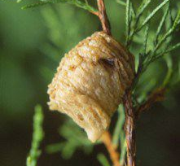
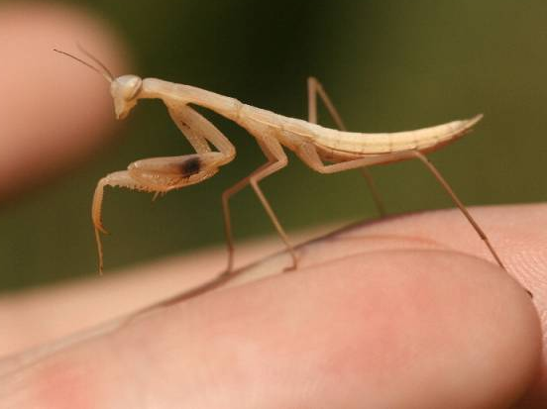
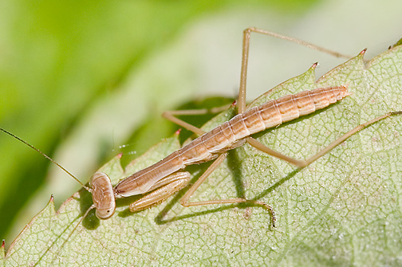
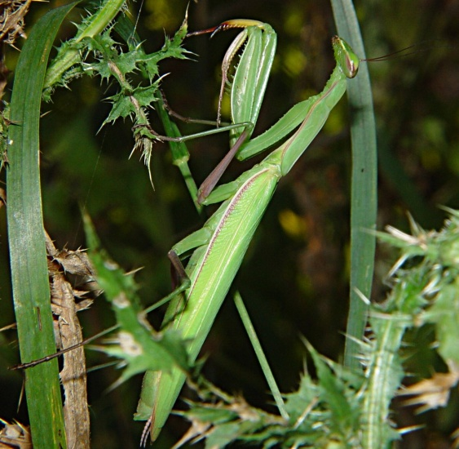
Insect Life Cycles: Complete or Incomplete?
Praying Mantis

Slide 7
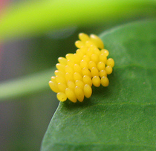
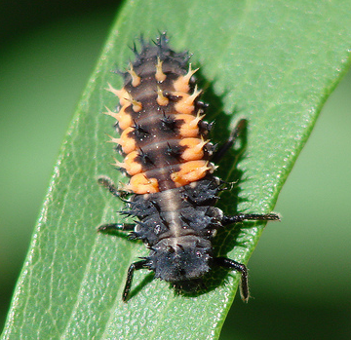
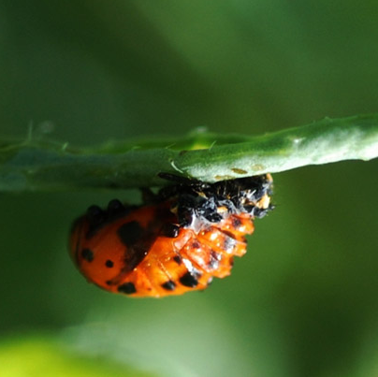
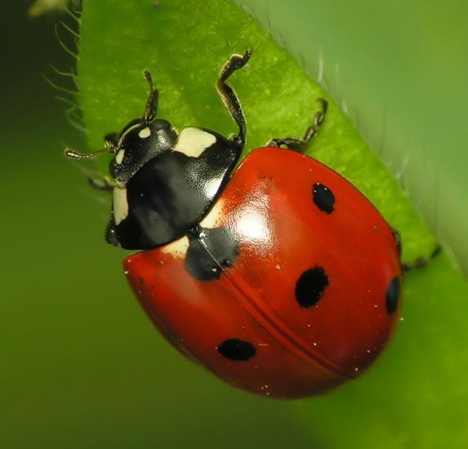
Insect Life Cycles: Complete or Incomplete?
Ladybug

Slide 8
Amphibians Life Cycles
The term “amphibian” means double life…
One life in the water,
One life on land.

Slide 9
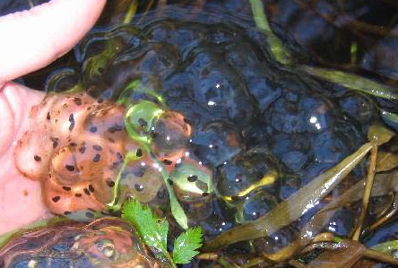
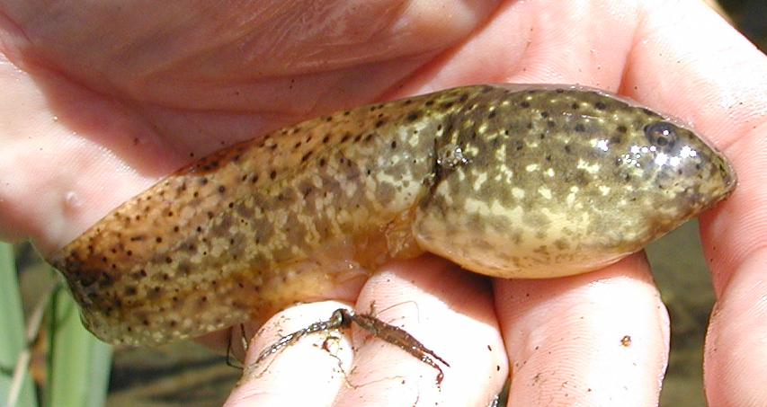

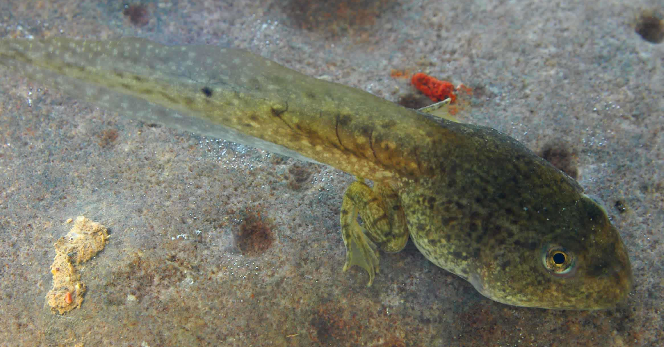
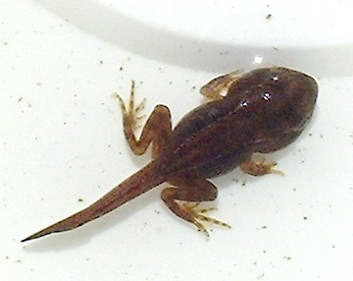
Amphibians Life Cycles: Frog

Slide 10
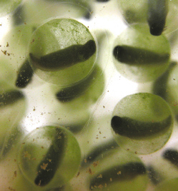
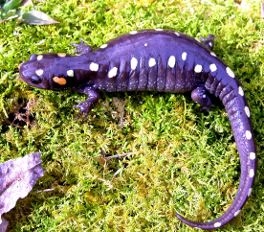
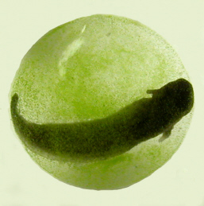
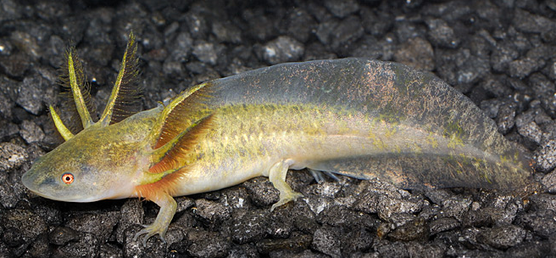
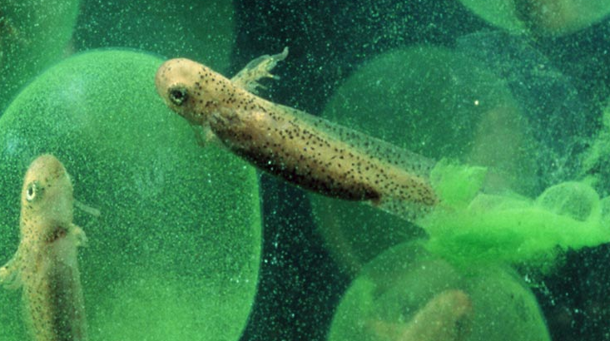
Amphibians Life Cycles: Salamander

Slide 11
Bird Life Cycles
Adult
Egg
Nestling
Fledgling

Slide 12
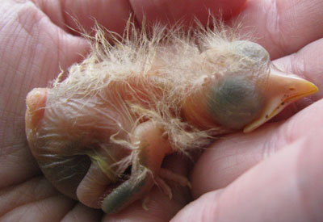

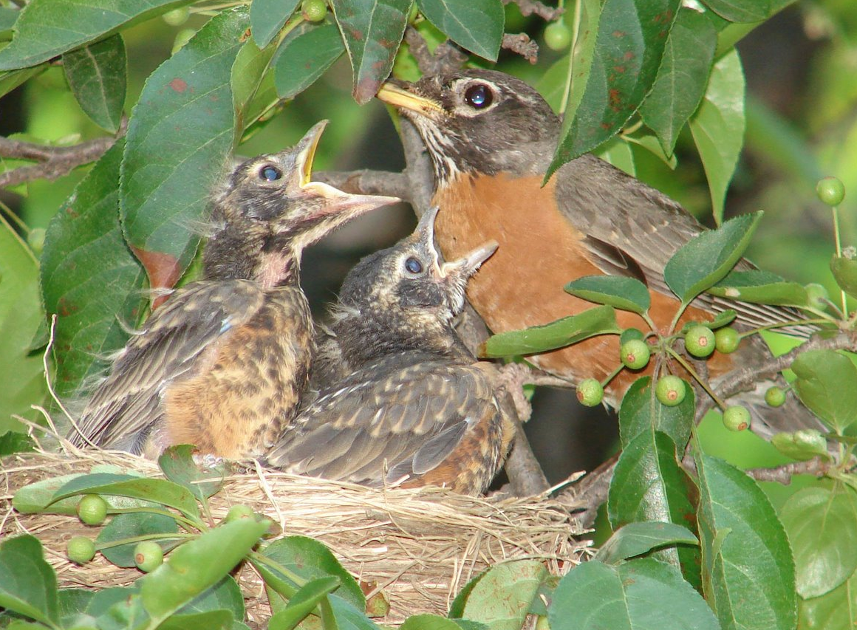
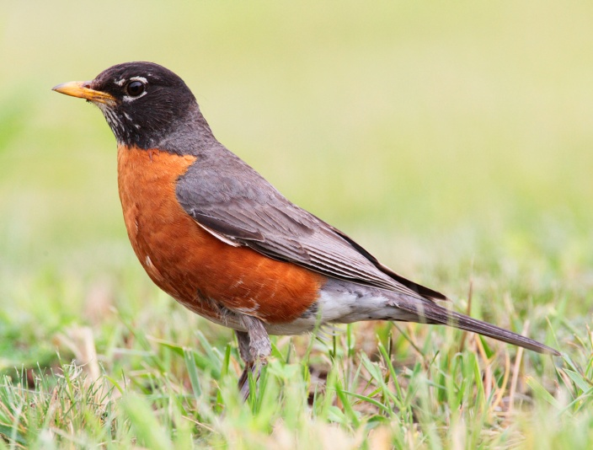
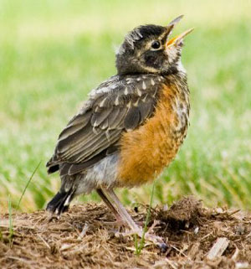
Bird Life Cycles: American Robin

Slide 13
Mammal Life Cycles
Embryo
Young
Adult

Slide 14
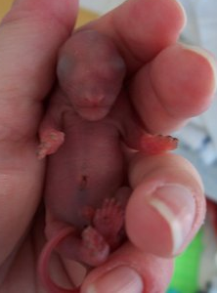
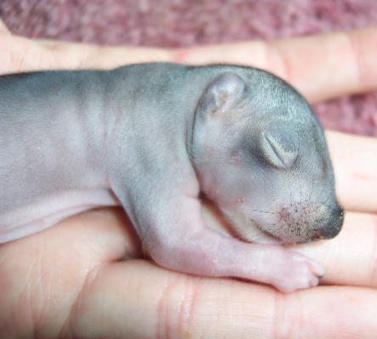
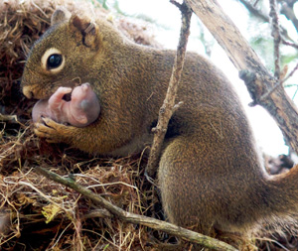
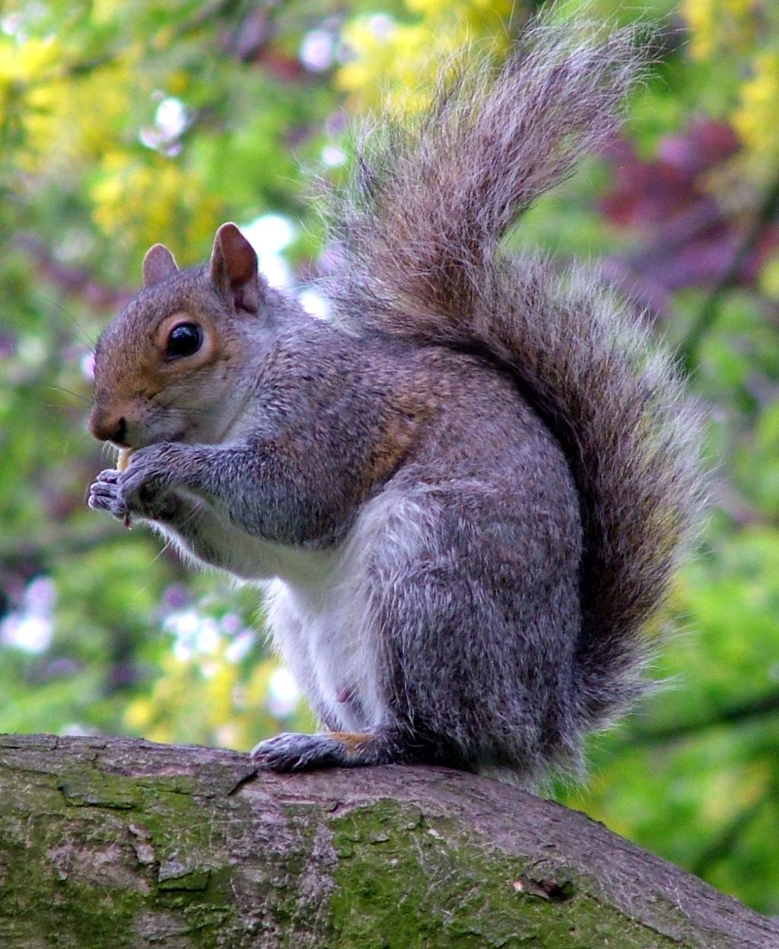
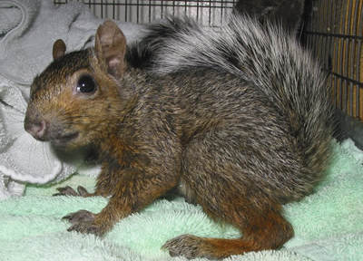
Mammal Life Cycles: Eastern Grey Squirrel

Slide 15
Plant Life Cycles
Seed
Seedling
Plant

Slide 16
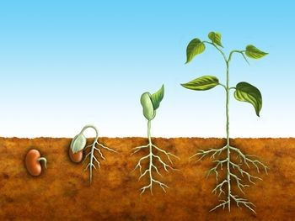
Plant Life Cycles: Bean

Slide 17
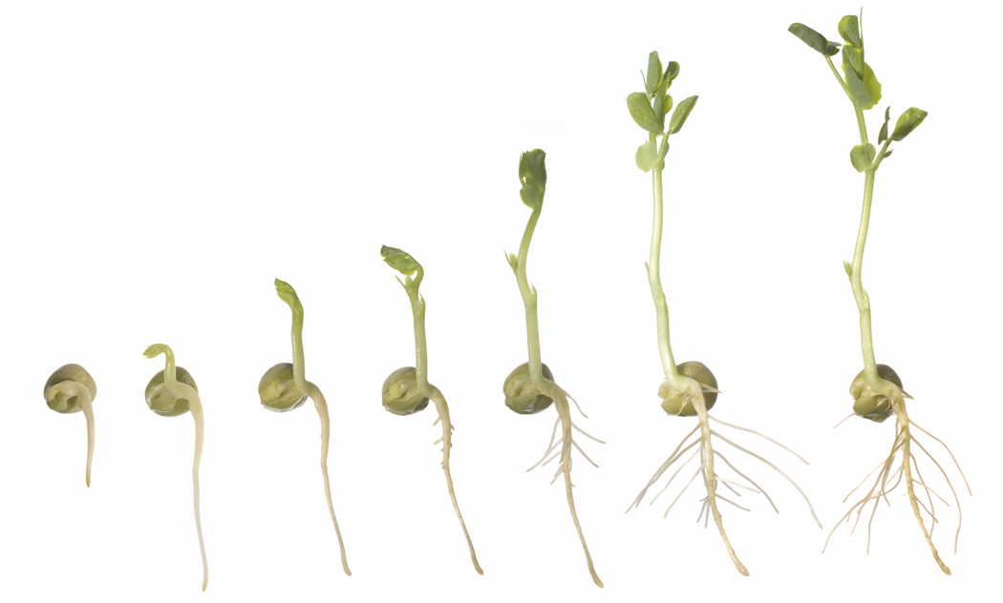

Slide 18

Questions?

