Slide 1
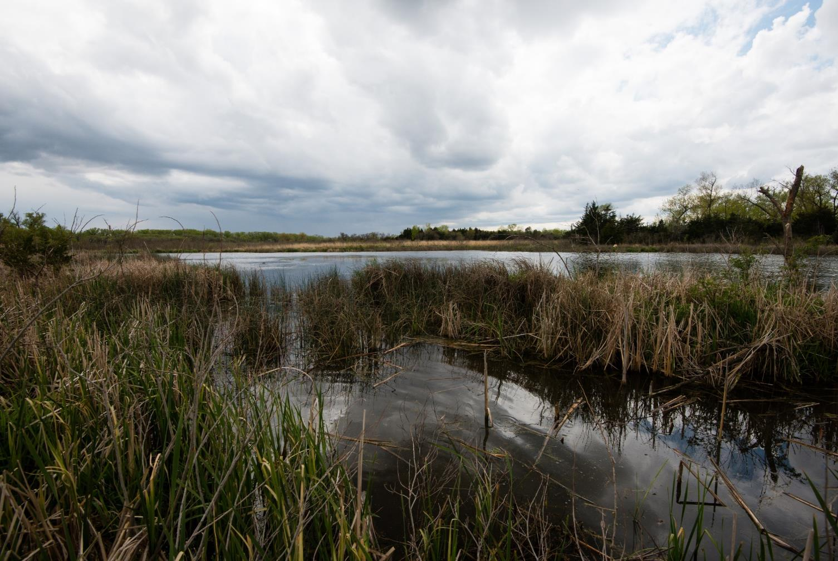

SCIENCE OF…
WETLANDS
Monica Macoubrie; Ted LaGrange, & Grace Gaard
Nebraska Game and Parks Commission
Monica.macoubrie@nebraska.gov

Slide 2
NGPC reserves the right to remove…
any comments not topically related to the particular content being commented upon;
profane language or content;
content that promotes, fosters, or perpetuates discrimination on the basis of race, creed, color, age, religion, gender, sexual orientation, marital status, national original, and/or physical or mental disability.
content that includes racism, hatred, libel, threats, obscenity, violence, or vulgarity;
content that is defaming or threatening in nature toward the agency, staff, volunteers and/or public;
sexual content or links to sexual content;
solicitations of commerce or advertisements;
conduct or encouragement of illegal activity;
information that may compromise the safety and security of the public or NGPC systems;
has personal information about another person or that violate a person’s privacy;
content that violates a copyright, trademark, or other legal ownership of any third party.

Slide 3
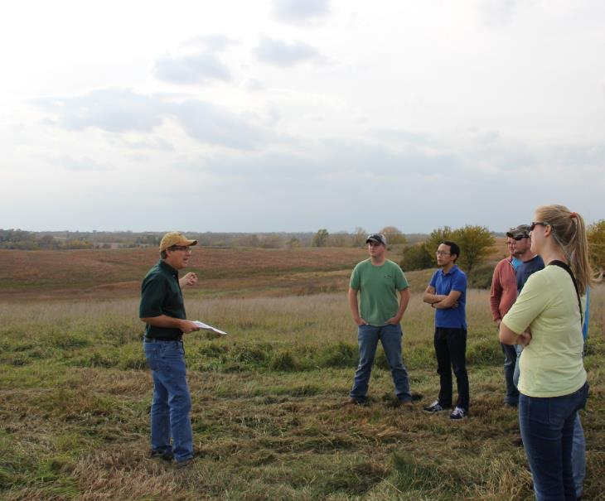
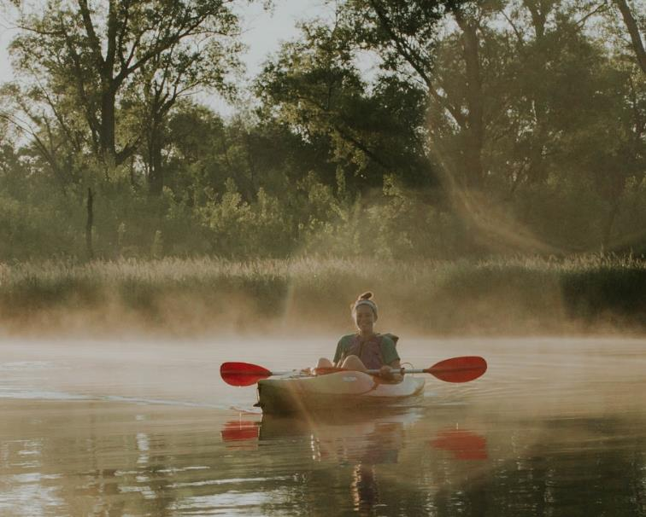
Ted LaGrange
Wetland Program Manager
Lisa Webb
M. Julie Photo
Grace Gaard
Aquatic Ecology Education Specialist

Slide 4

Today’s Agenda
What is a wetland?
What do wetlands do?
Losses & Threats
Nebraska Wetland Types
Dynamics
Conservation Initiatives
Recreational Opportunities

Slide 5
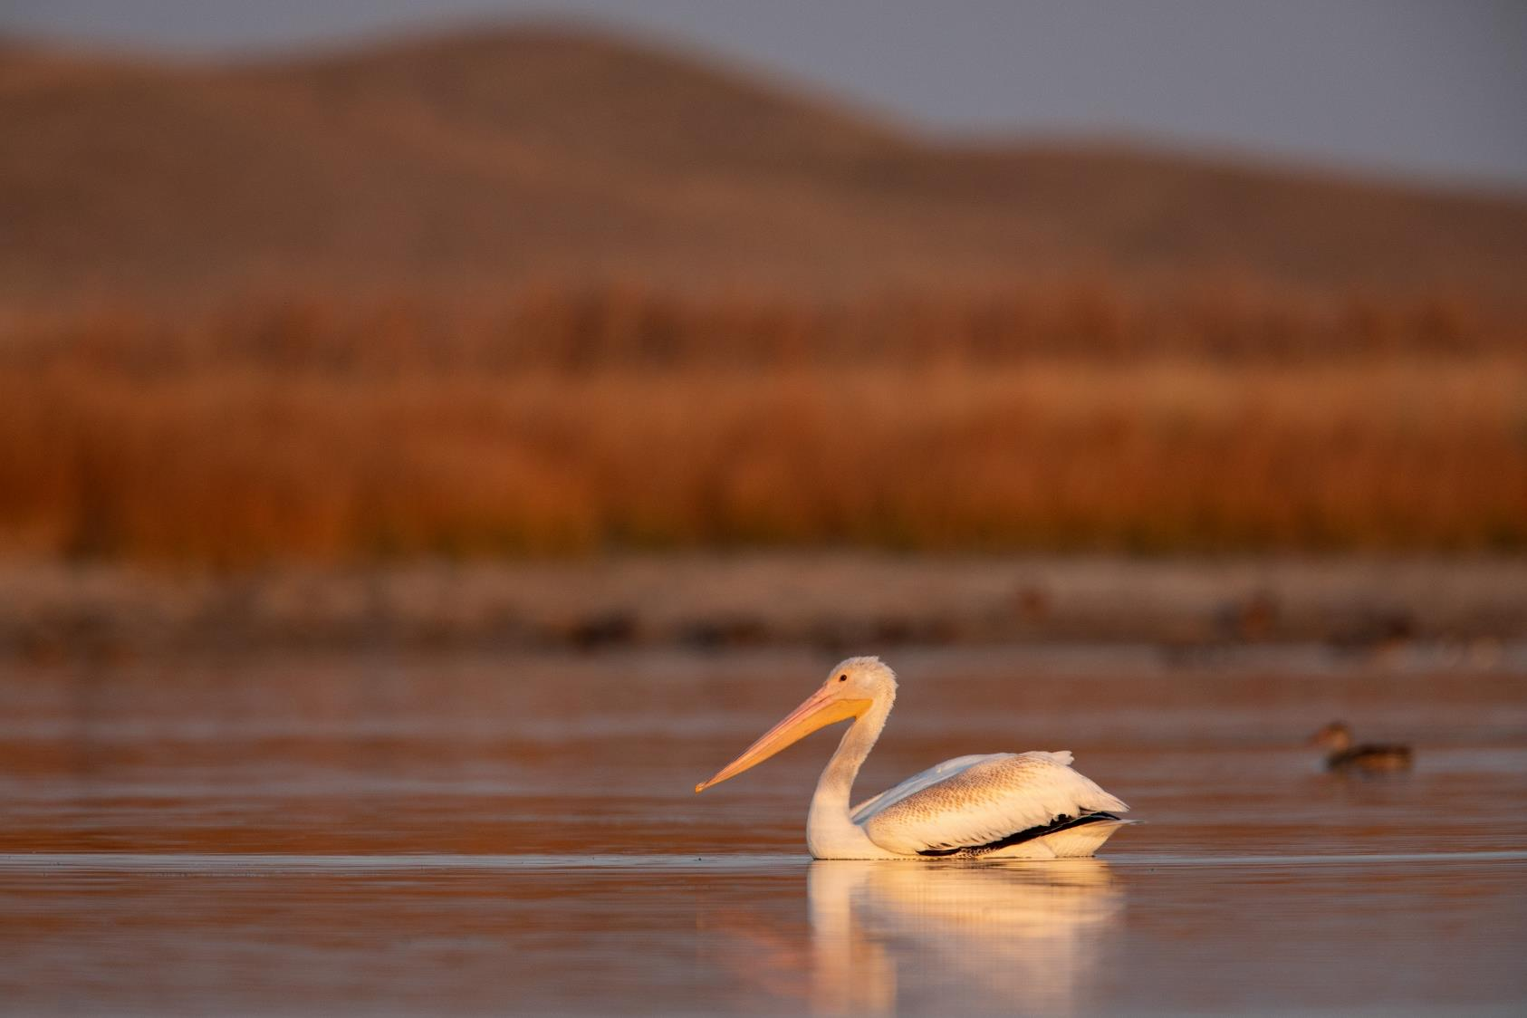
What is a Wetland?
An area that is saturated (filled) with surface water or groundwater
  This water exists often enough and/or for long enough that it can support specific plant communities adapted to soggy soils
Wetlands include swamps, marshes, bogs, and similar areas
Ethan Freese / Platte Basin Timelapse

Slide 6
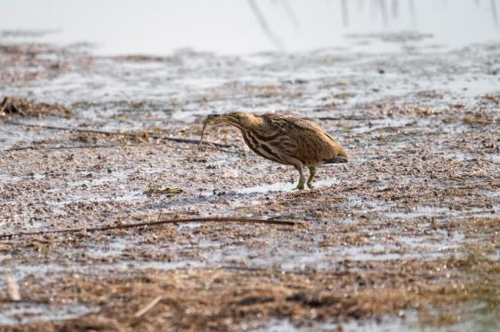
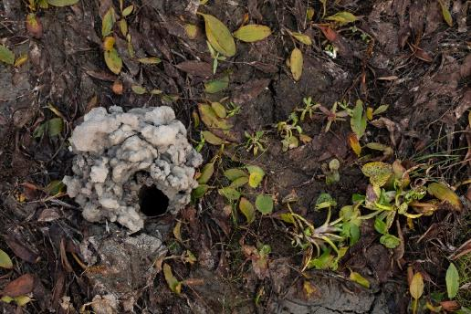
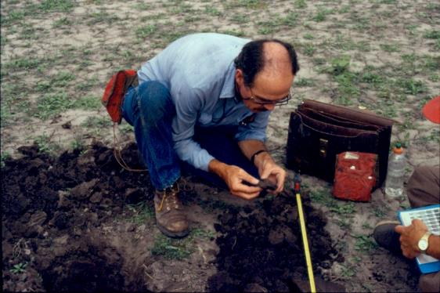
Soil
Wetland soils are Hydric
Typically develop in areas underwater with little to no oxygen
Contain a lot of organic matter
Grant Reiner / Platte Basin Timelapse
Ethan Freese / Platte Basin Timelapse

Slide 7
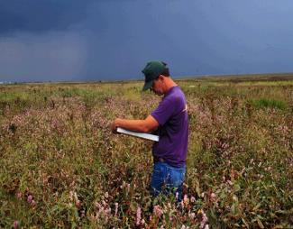
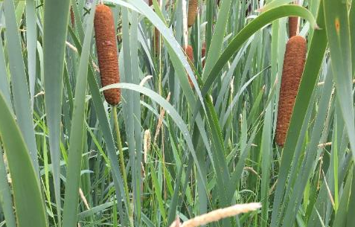
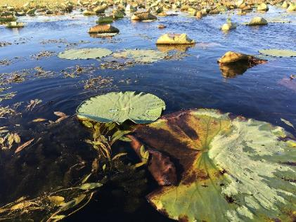
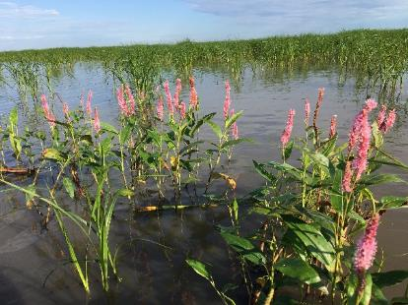
Plant Community
Specific species that are adapted to live and reproduce in anaerobic conditions
Ted LaGrange
Ted LaGrange
Ted LaGrange

Slide 8
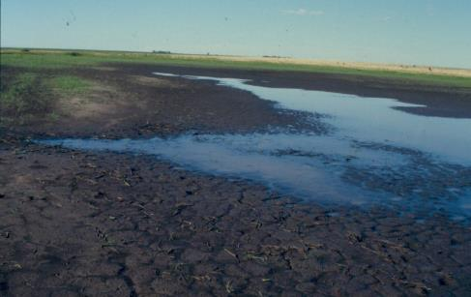
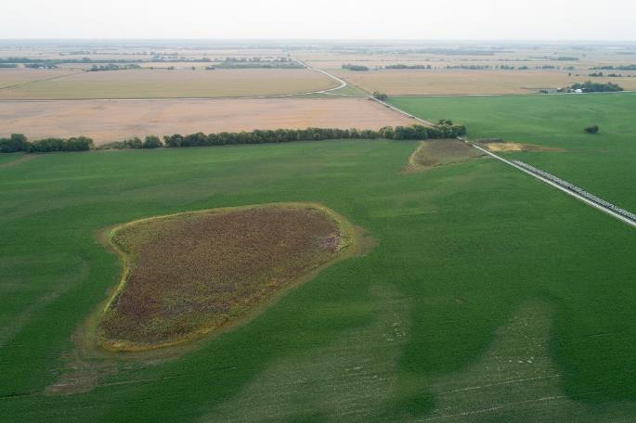
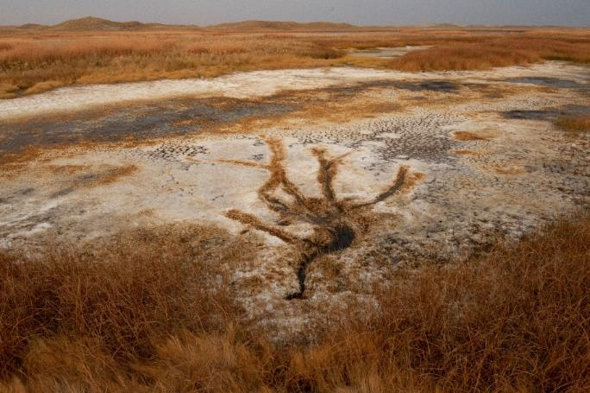
Hydrology
Saturated, especially during spring and summer
Wetlands are not always wet!
Ethan Freese / Platte Basin Timelapse
Grant Reiner / Platte Basin Timelapse

Slide 9
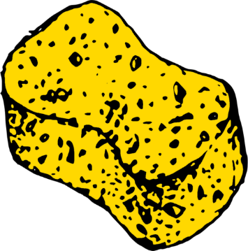
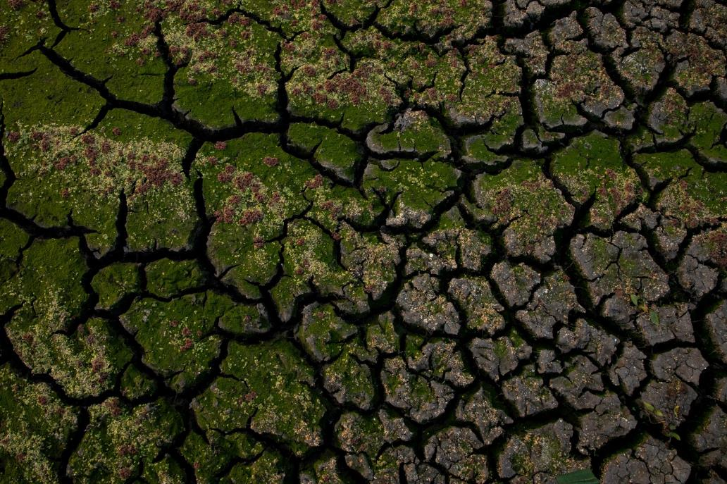
What do Wetlands do?
Absorb water like a sponge
Think ecosystem services!
Ethan Freese / Platte Basin Timelapse

Slide 10
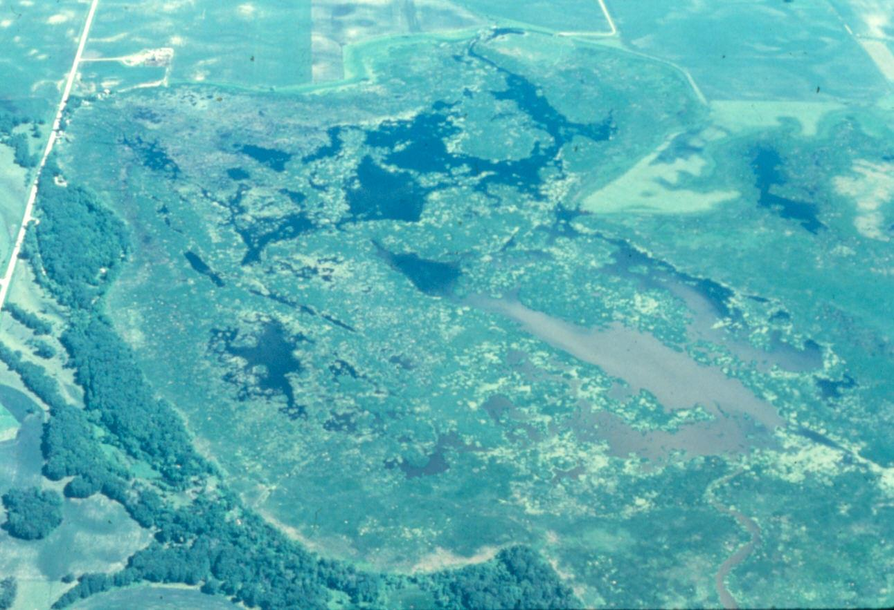
Improve Water Quality
FILTER OUT POLLUTANTS

Slide 11
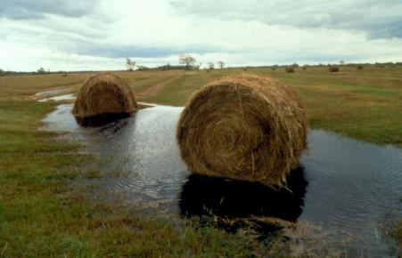
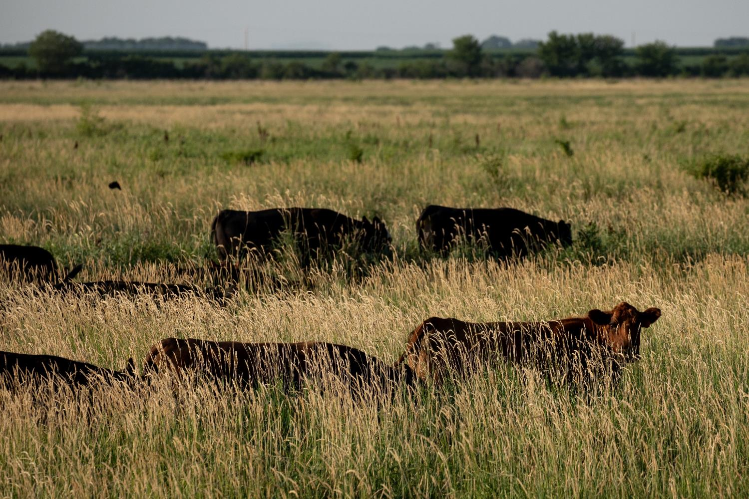
Produce Food and Fiber
Ethan Freese / Platte Basin Timelapse

Slide 12

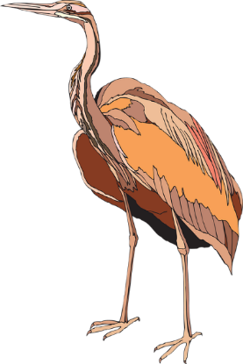
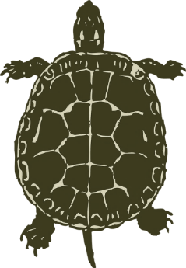

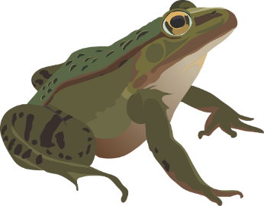
Provide Habitat for Fish, Wildlife and Plants
Wetlands are the most productive natural system in Nebraska
50%
100%
38%
50%
36%

Slide 13
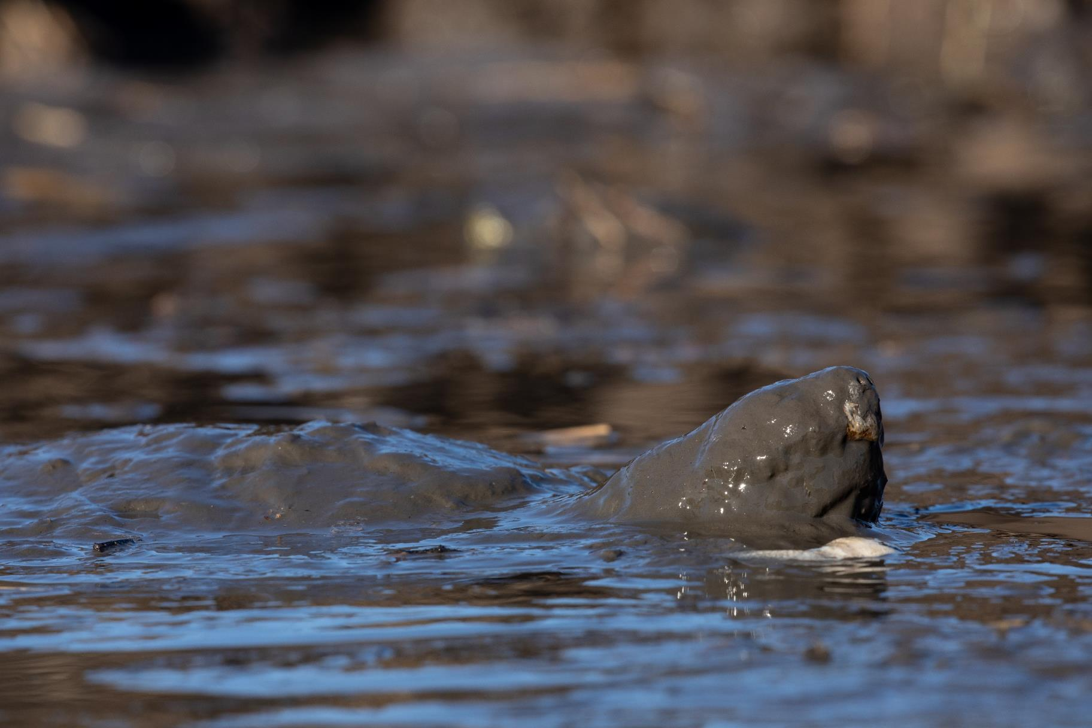
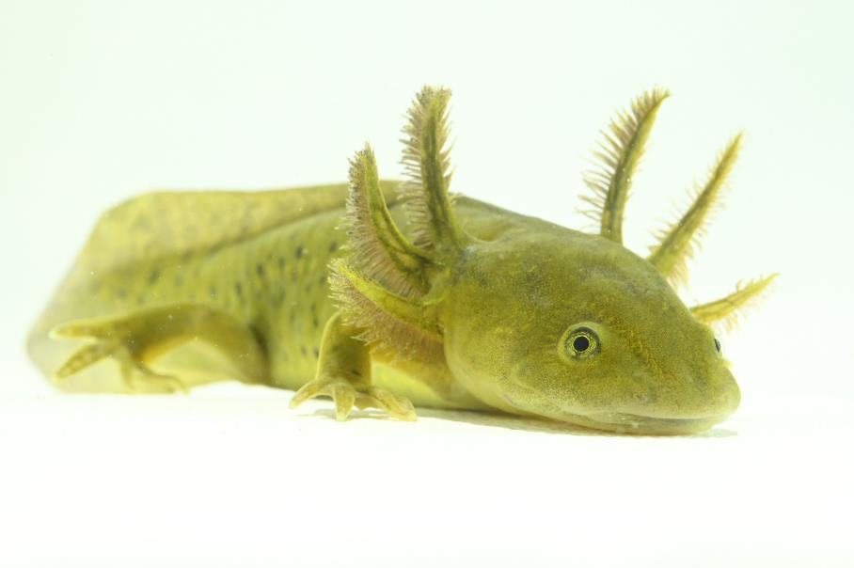
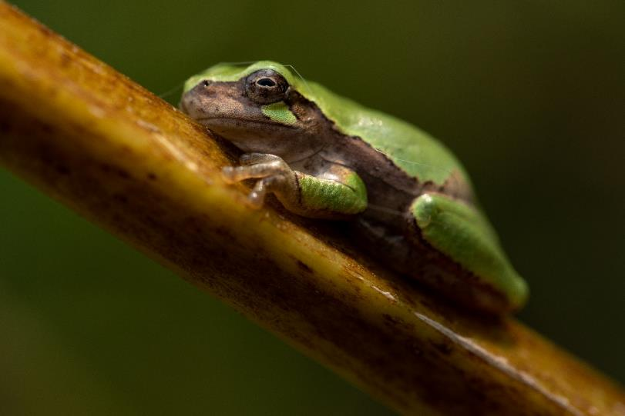
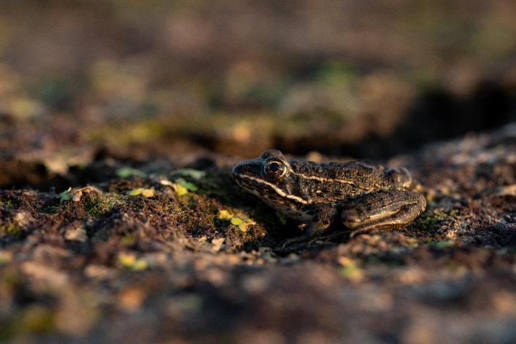

Amphibians and Reptiles
Grant Reiner / Platte Basin Timelapse
Ethan Freese / Platte Basin Timelapse – Turtle and Frogs

Slide 14
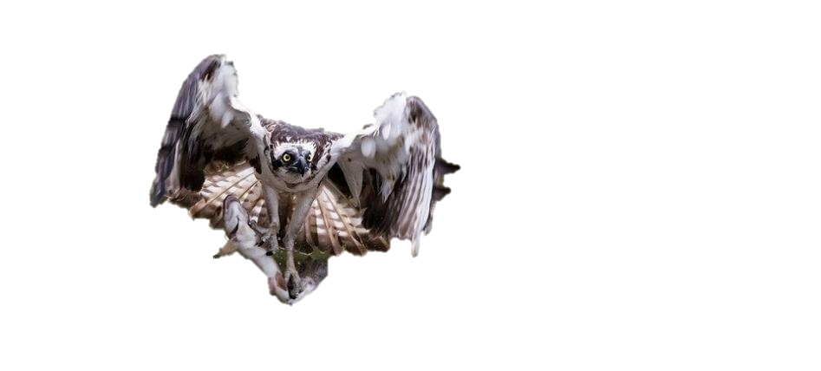
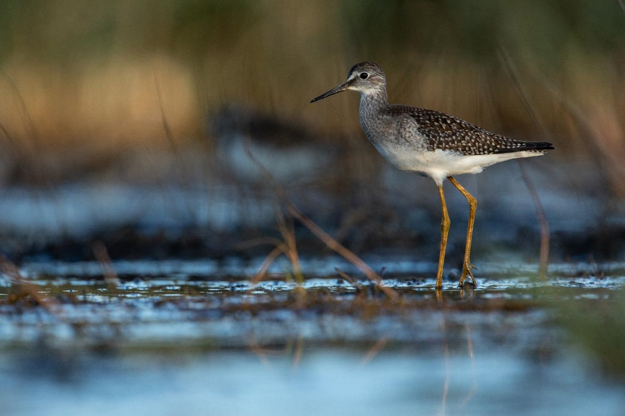
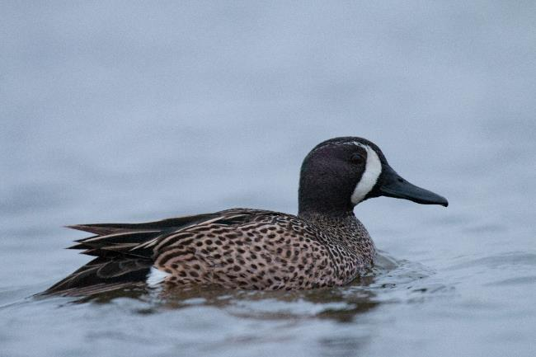
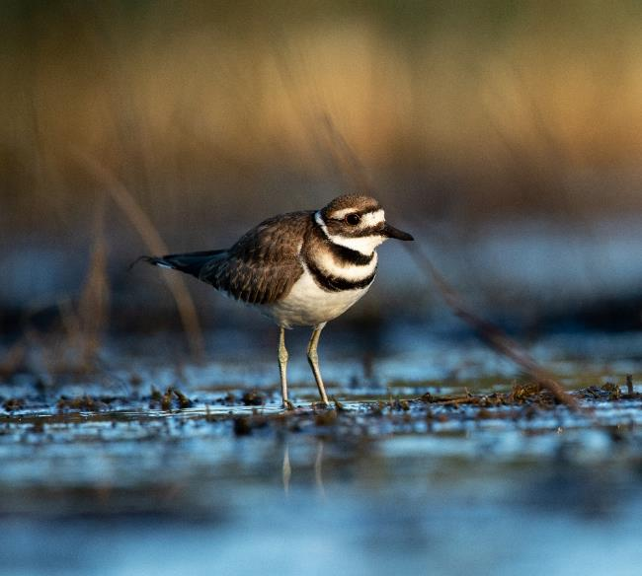
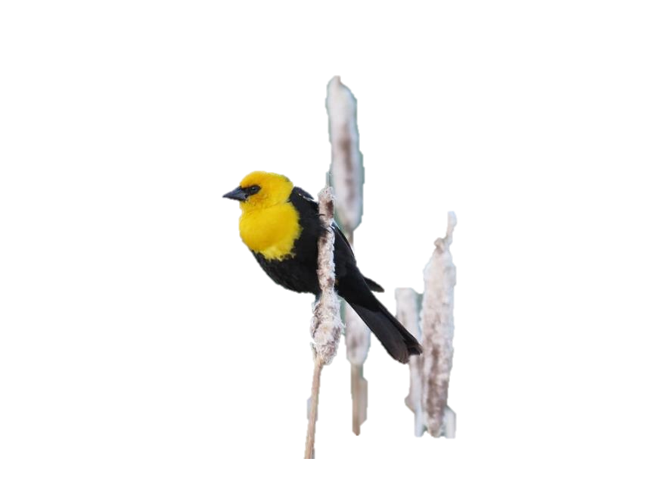
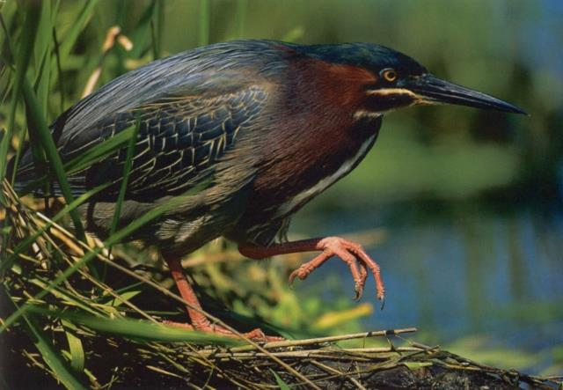
Bird Diversity
Ethan Freese / Platte Basin Timelapse
Ethan Freese / Platte Basin Timelapse
Ethan Freese / Platte Basin Timelapse

Slide 15
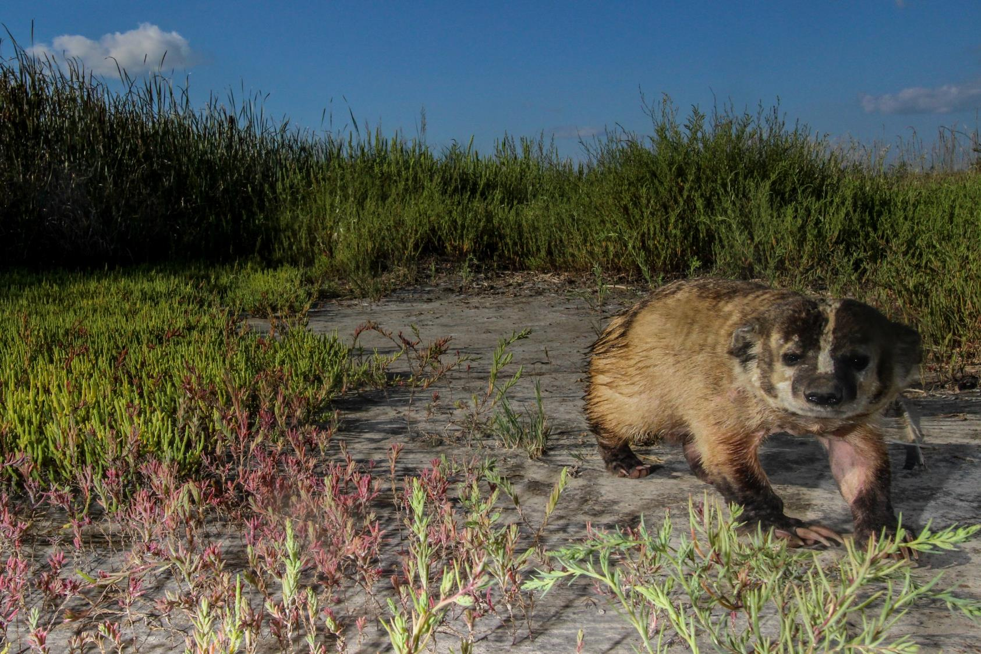
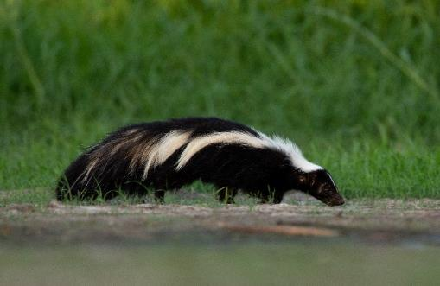
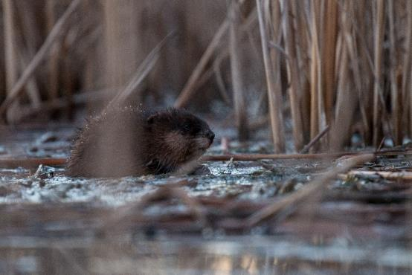
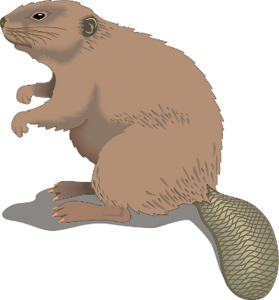
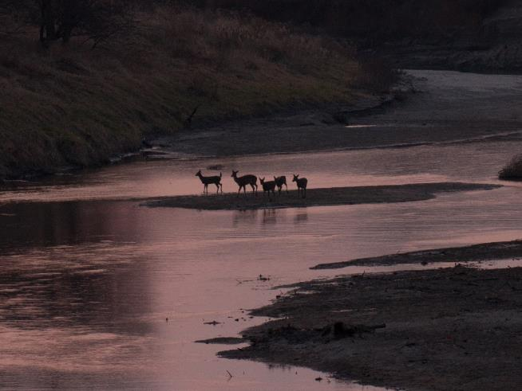
Mammals
All photos by Ethan Freese / Platte Basin Timelapse

Slide 16
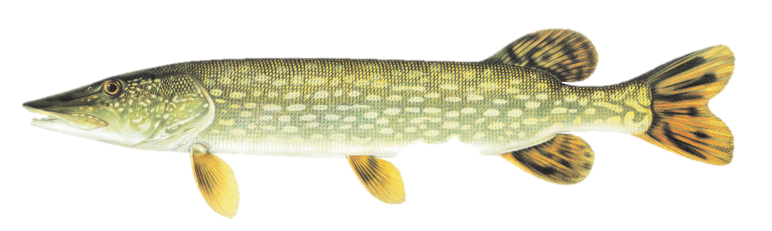
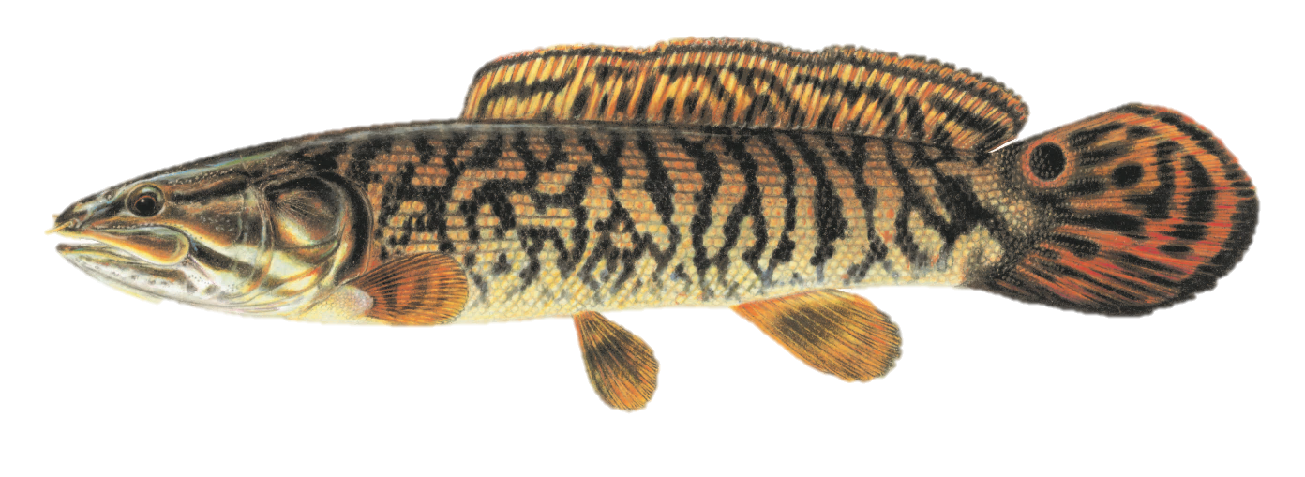
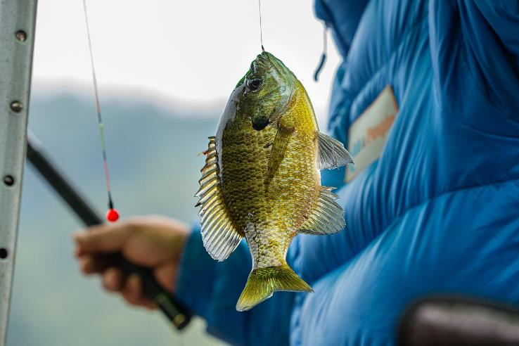
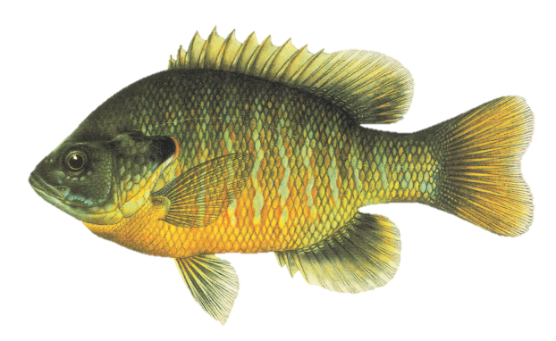
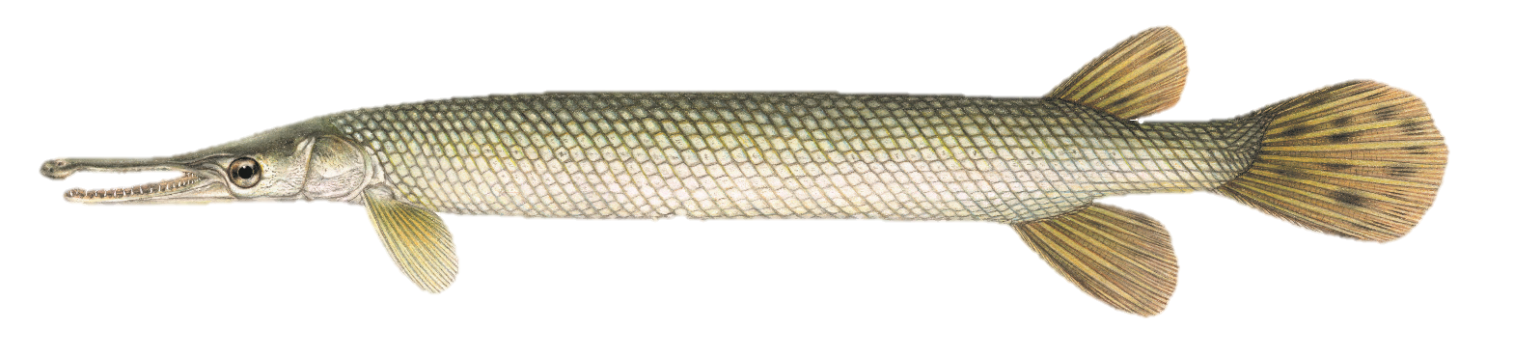
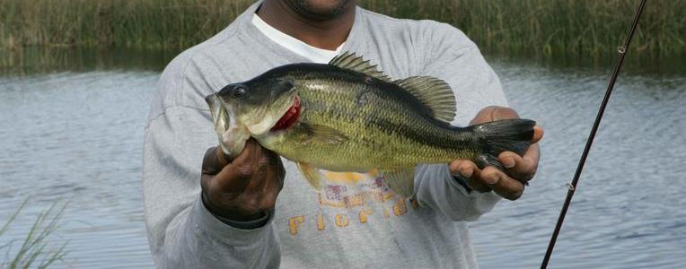
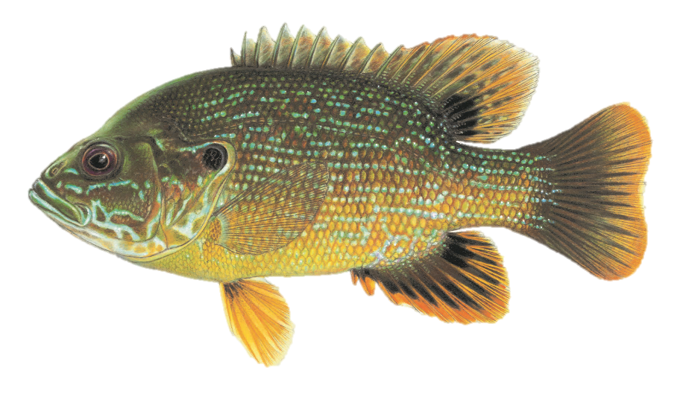
Fish

Slide 17
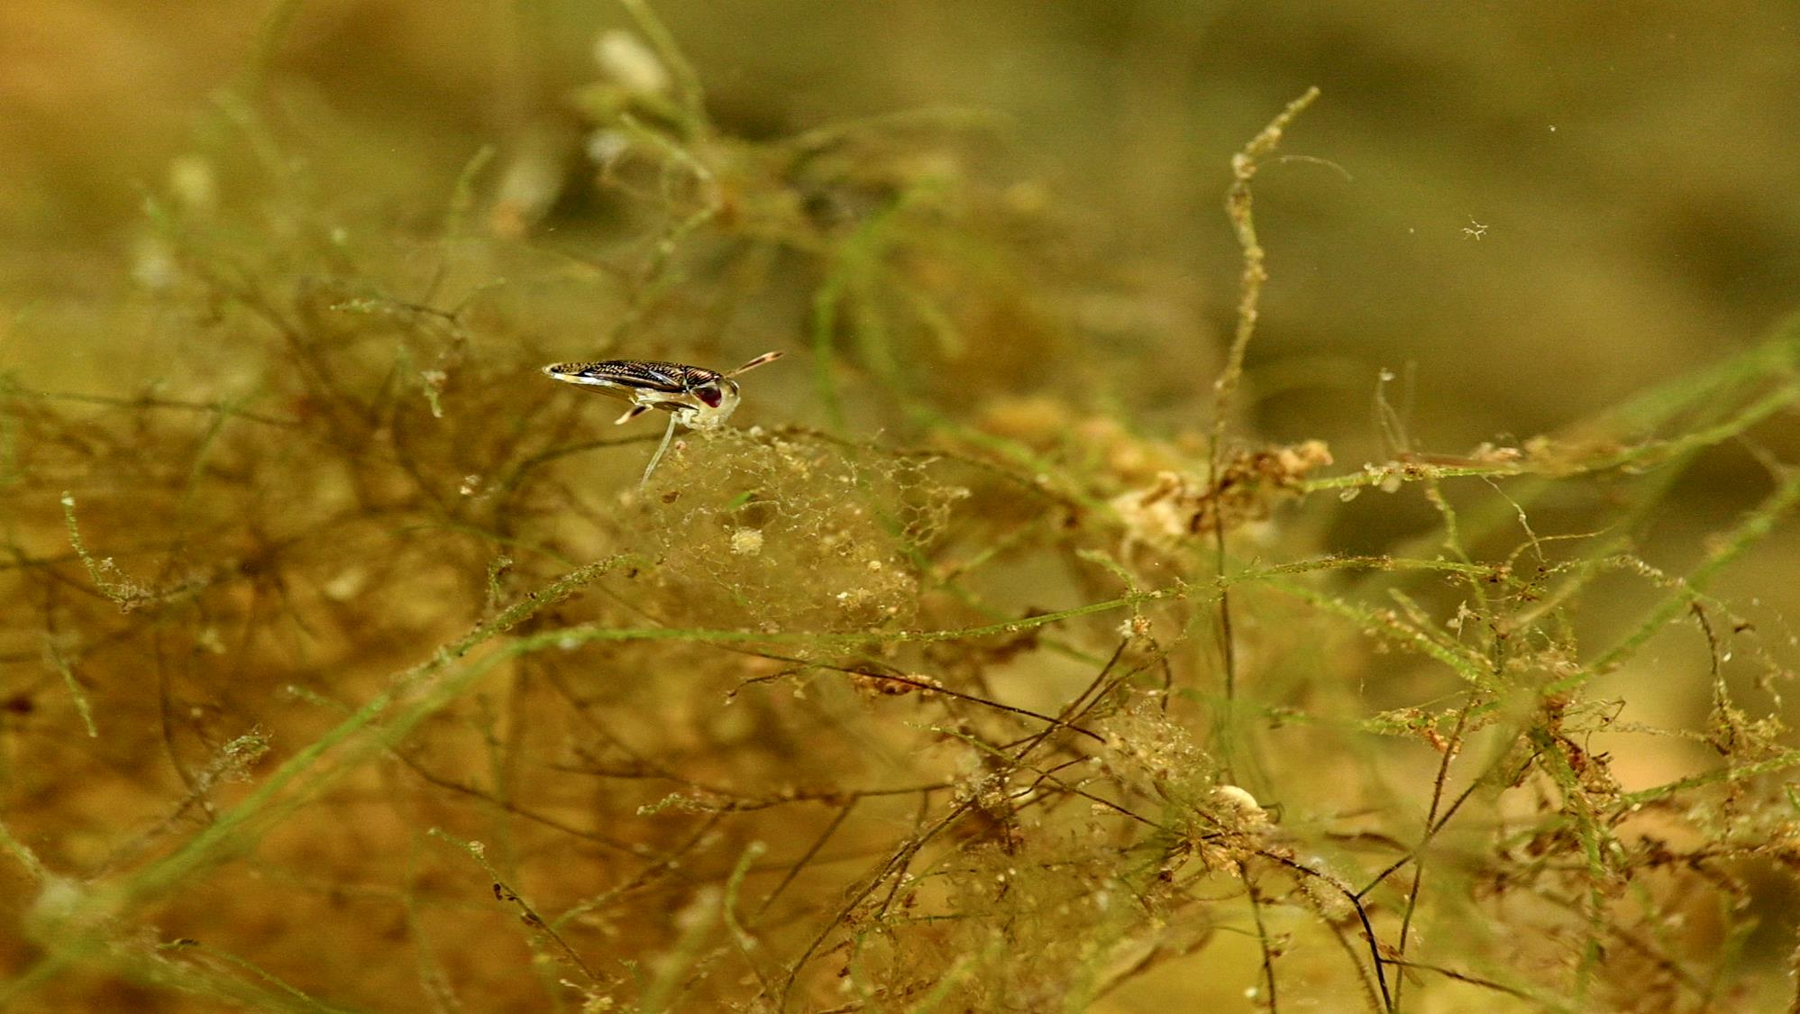
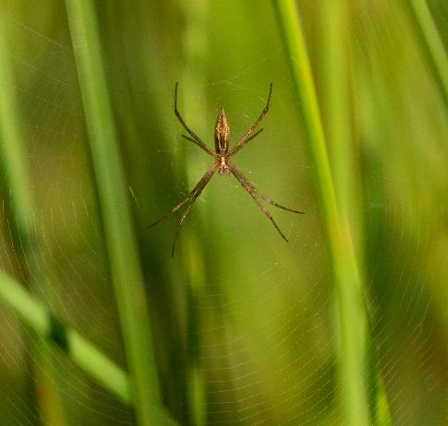
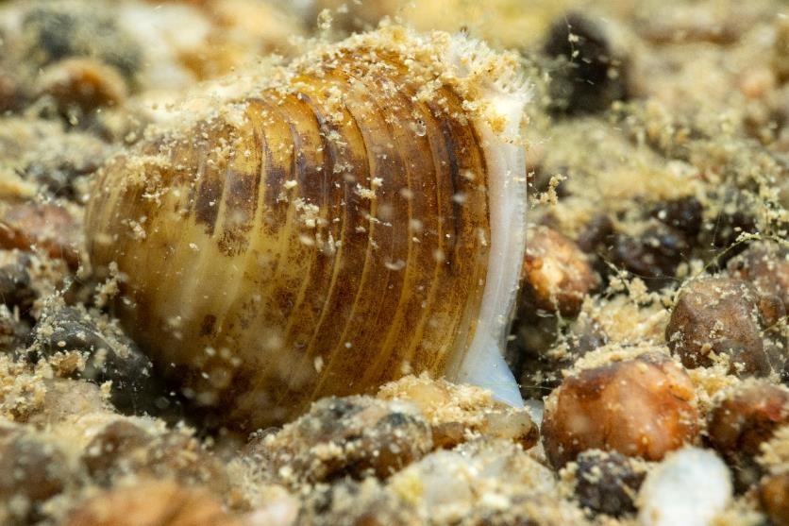
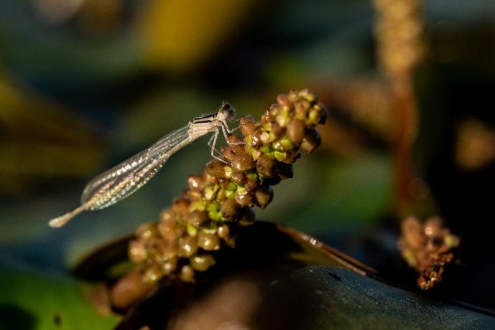
Invertebrates
Ethan Freese / Platte Basin Timelapse
Ethan Freese / Platte Basin Timelapse
Grant Reiner / Platte Basin Timelapse
Grant Reiner / Platte Basin Timelapse

Slide 18
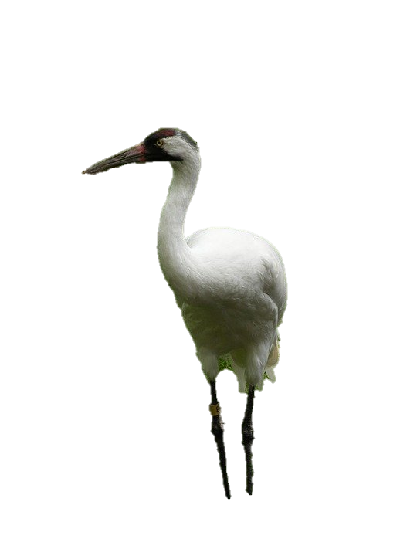
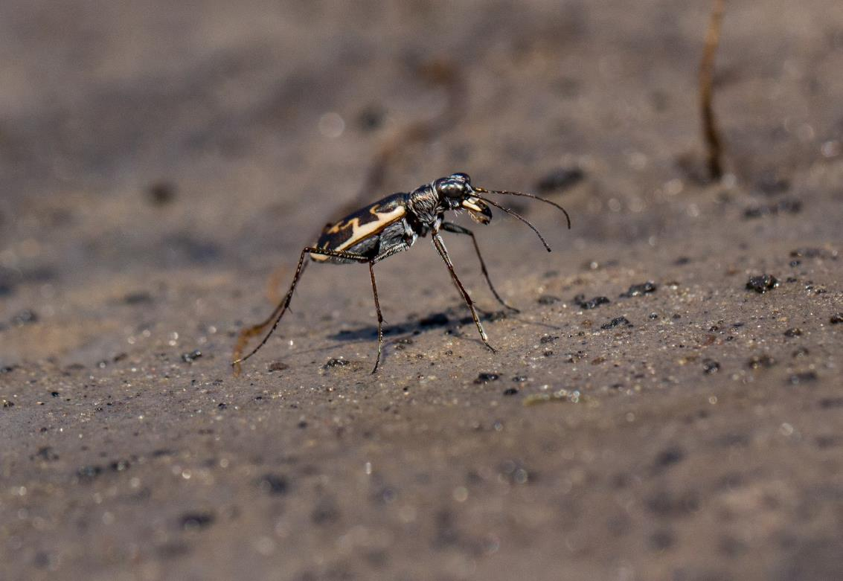

75% of our Threatened and Endangered species rely on wetlands
Ethan Freese / Platte Basin Timelapse

Slide 19

Recreation
Grant Reiner / Platte Basin Timelapse

Slide 20

Wetland Loss and Threats

Slide 21






Slide 22




Slide 23





Slide 24

Estimates of wetland acres in 1780, 1980 and percent loss
South Dakota
2,735,100
1,780,000
35%
Wyoming
2,000,000
1,250,000
37%
Iowa
Nebraska
4,000,000
425,000
90%
2,910,500
1,905,500
35%
90%
Colorado
Missouri
2,000,000
1,000,000
50%
Kansas
4,844,000
643,000
87%
841,000
435,400
37%
Estimated acres in 1780
Estimated acres in 1980
Percent loss
Dahl 1990

Slide 25
Wetland Threats
Sedimentation
Loss of Stream Equilibrium
Drainage and Filling
Lack of Management
Invasive Species

Slide 26



Slide 27




Wetland Invaders
Purple
Loosestrife
Reed Canary Grass and Hybrid Cattail
Trees
Phragmites

Slide 28




Notes:
Shows degraded riverine, sandhills, playa, and saline wetlands. In need of restoration.

Slide 29


Slide 30


Sandhills
Alkali
Ethan Freese / Platte Basin Timelapse

Slide 31



Sandhills

Slide 32



Slide 33

Riverine
Ethan Freese / Platte Basin Timelapse

Slide 34



Platte River
NEBRASKAland
NEBRASKAland
Ethan Freese / Platte Basin Timelapse

Slide 35



Elk Horn
Niobrara
Missouri

Slide 36

Playa
Ethan Freese / Platte Basin Timelapse

Slide 37



Rainwater Basin
Ryan Askren

Slide 38



Other Playa Wetlands

Slide 39

Saline
Ethan Freese / Platte Basin Timelapse

Slide 40



Ethan Freese / Platte Basin Timelapse

Slide 41





Wetlands are everywhere

Slide 42

URBAN
Ethan Freese / Platte Basin Timelapse

Slide 43

WETLANDS ARE DYNAMIC!

Slide 44



Slide 45


Slide 46


Slide 47


Slide 48

WETLAND CONSERVATION

Slide 49


Regulations
Section 404 of Clean Water Act
Farm Bill- Swampbuster
NDEE State Title 117

Slide 50



Protection

Slide 51

Private Lands Programs

Slide 52

Restoration
Ethan Freese / Platte Basin Timelapse

Slide 53




Interdisciplinary Team

Slide 54




Management

Slide 55

Wetland Complexes
Nebraska Natural Legacy Plan
Wetland BULs

Slide 56



Rainwater Basin Joint Venture
Niki Messmer
Ryan Askren

Slide 57



Sandhills Task Force

Slide 58



Saline Wetlands Conservation Partnership
Michael Forsberg / Platte Basin Timelapse
Photo by: Mike Forsberg

Slide 59




Science

Slide 60







You Can be a Wetlands Scientist too!

Slide 61

Recreation in Wetlands
M. Julie Photo

Slide 62






Fun things to do!
Eric Fowler / Nebraska Game and Parks Commission
Hunting
Hiking
Collecting Scientific Data!
  iNaturalist
  eBird

Slide 63

Recreating Responsibly
Familiarize with these Leave No Trace principles
    Plan Ahead and Prepare
    Travel on Durable Surfaces When Possible
    Dispose of Waste Properly
    Leave What You Find
    Minimize Campfire Impacts
    Respect Wildlife
    Be Considerate of Other Visitors

Slide 64




Wetlands of Nebraska Outreach and Education Project
NebraskaWetlands.com

Slide 65

Thank you for joining us!
Any Questions?
Ethan Freese / Platte Basin Timelapse

Slide 66
Want more?
Nebraska Game and Parks Education YouTube Channel- Under playlists; “Science of…”
Nebraska Wildlife Education Facebook Page- https://www.facebook.com/NGPCWildlifeEducation
Nebraska Wildlife Education Instagram Page-
https://www.instagram.com/nebraskawildlifeeducation/
Nebraska Game and Parks Commission's Page-
http://outdoornebraska.gov/wildlifeeducation/

Slide 67
Thank you!!
Join me starting on May 13th with Butterflies & Moths!

