Slide 1
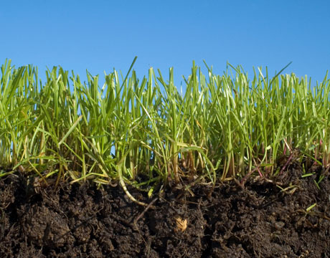
Soils
Lindsay Rogers
Nebraska Game & Parks Commission

Slide 2
Soil Forming Factors
Parent Material
Climate
Precipitation
Temperature
Biota
Topography
Time

Slide 3
Soil Forming Factors
Parent Material
What the soil is made from will determine what kind of soil it becomes and what kinds of minerals the soil contains.

Slide 4
Soil Forming Factors
Climate
Precipitation
water erosion
humid areas… more leaching
more moisture encourages vegetation … leads to greater organic matter

Slide 5
Soil Forming Factors
Climate
Temperature
warmer areas have more erosion
decomposition happens faster in warmer areas… leads to more organic material

Slide 6
Soil Forming Factors
Biota
Microorganisms help decompose organic material.
Burrowing animals effect soil horizons

Slide 7
Soil Forming Factors
Topography
Steep hills vs. slopes
Depressions in the soil
Hill dorection

Slide 8
Soil Forming Factors
Time
All soil development requires time… the amount of time depends on the other soil forming factors.

Slide 9
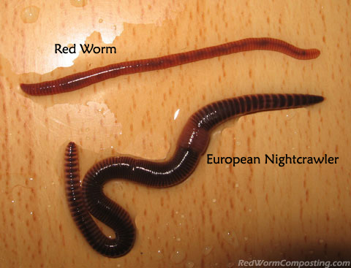
Soil Organisms
Worms

Slide 10
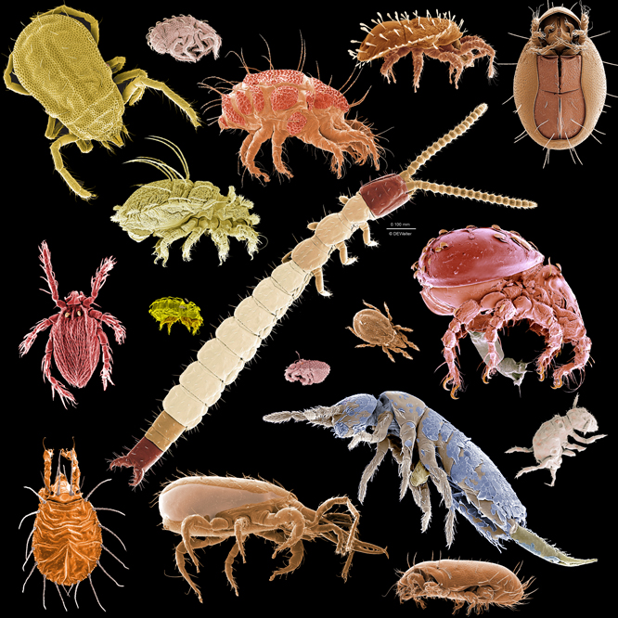
Soil Organisms
Mites

Slide 11
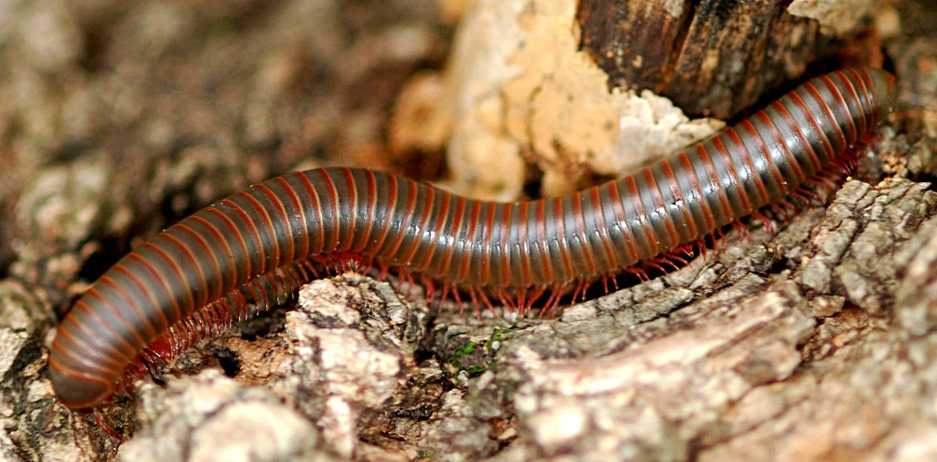
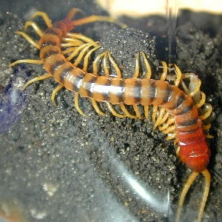
Soil Organisms
Centipedes & Millipedes

Slide 12
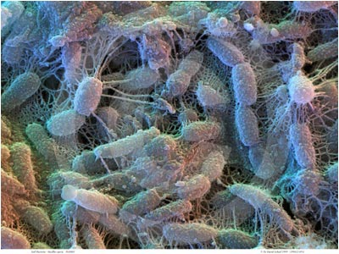
Soil Organisms
Bacteria

Slide 13
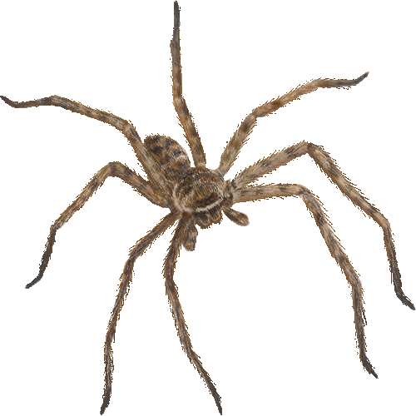
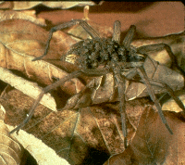
Soil Organisms
Spiders

Slide 14
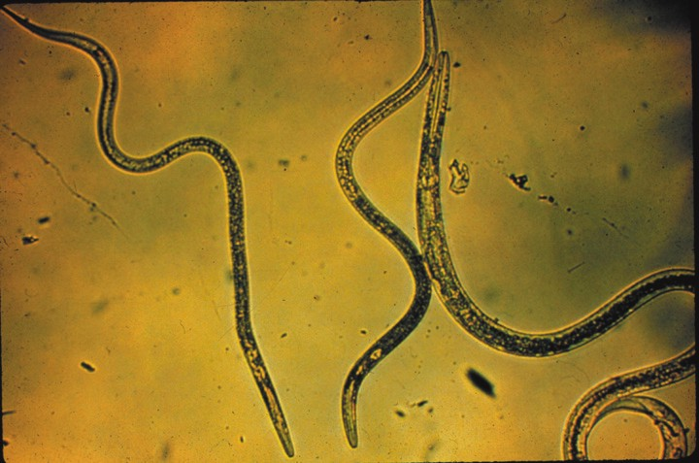
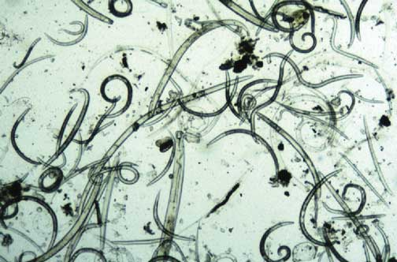
Soil Organisms
Nematodes

Slide 15
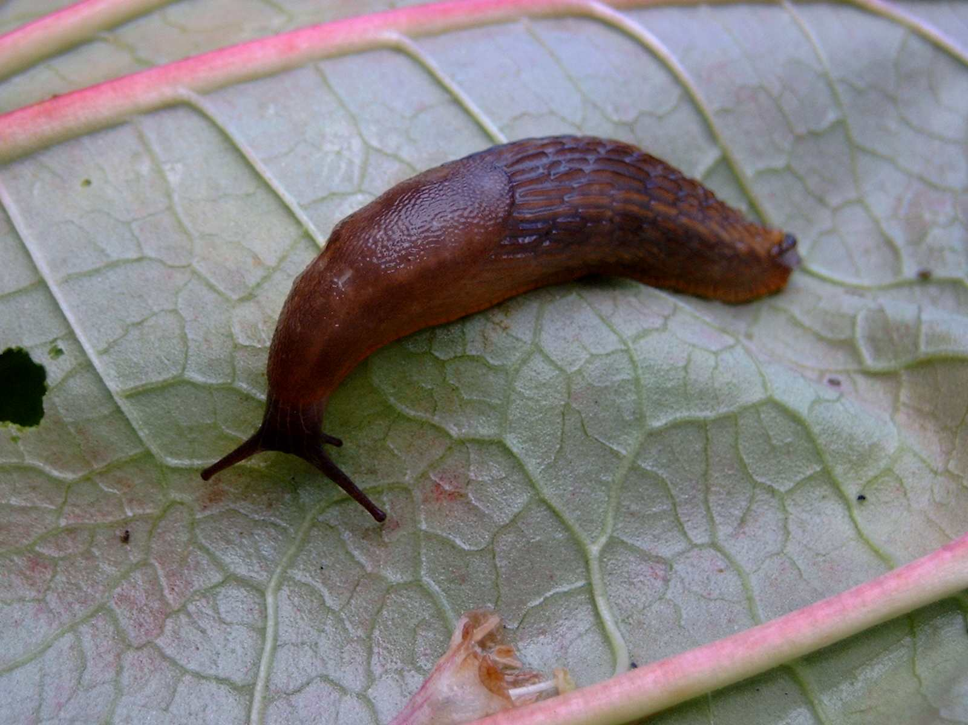
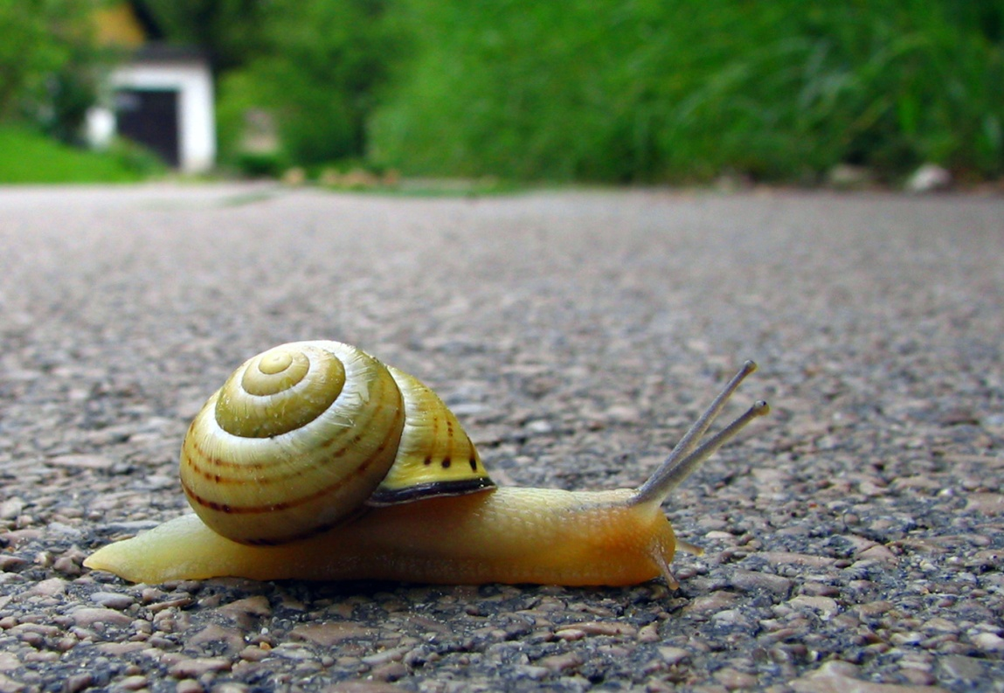
Soil Organisms
Slug and Snails

Slide 16
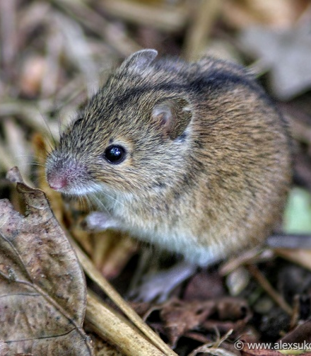
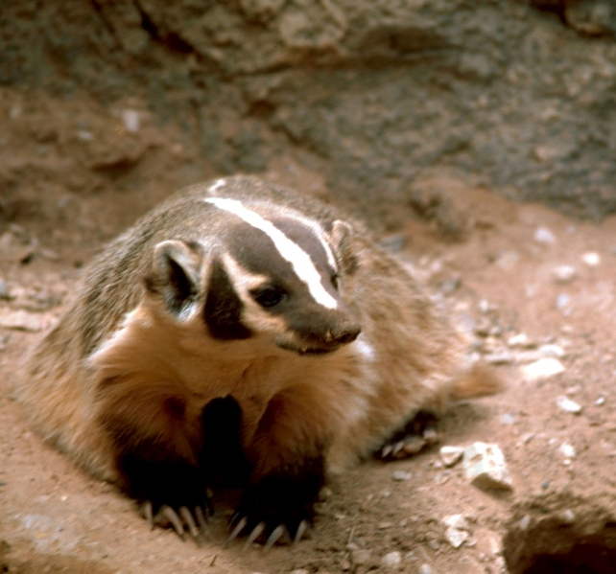
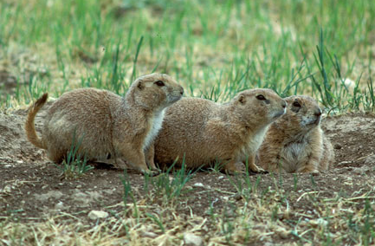
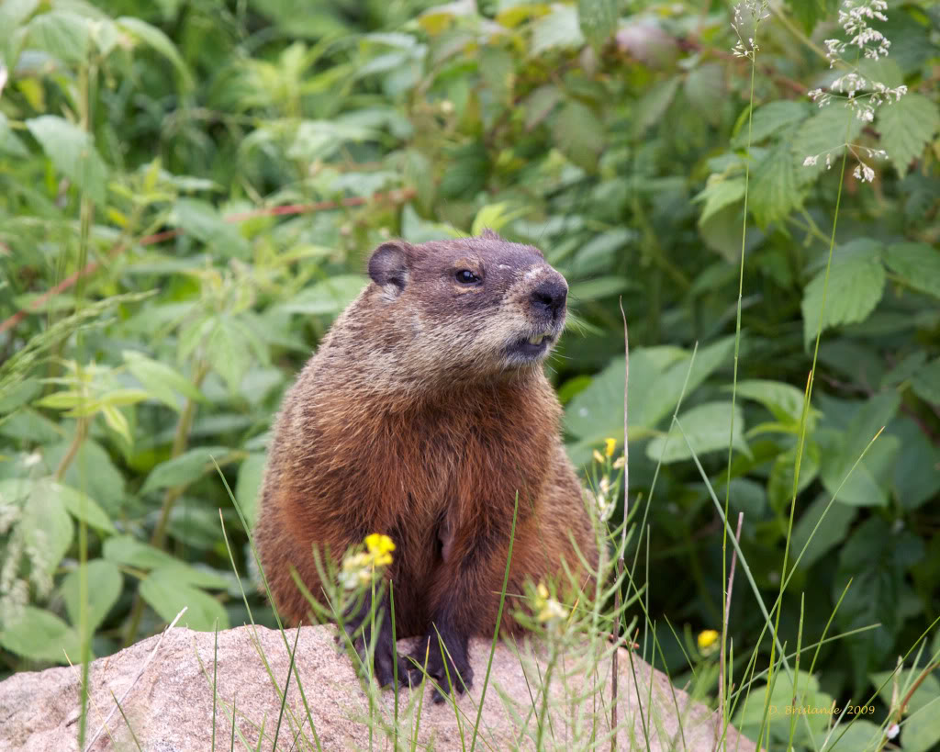
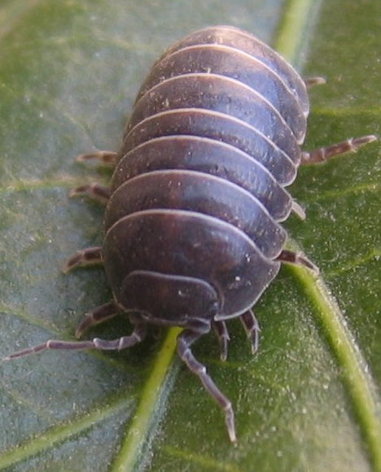
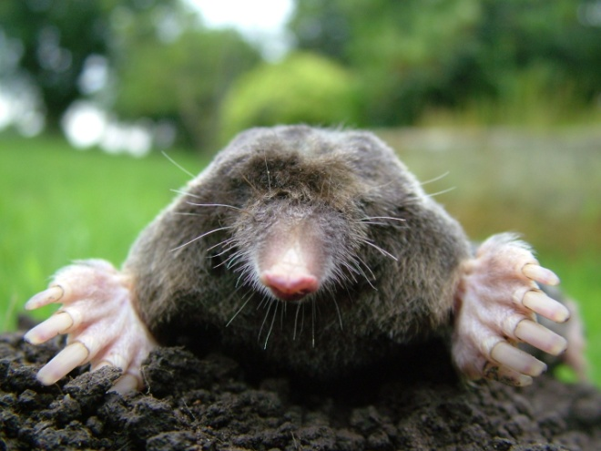
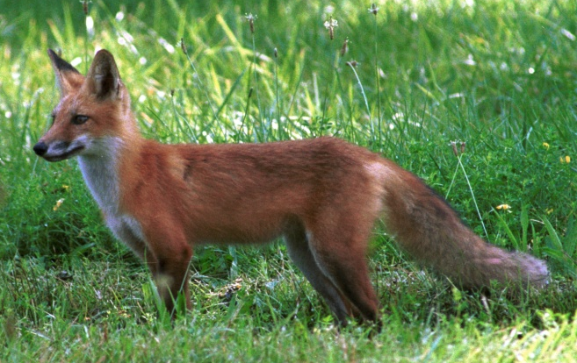
Soil Organisms
Other Animals

Slide 17
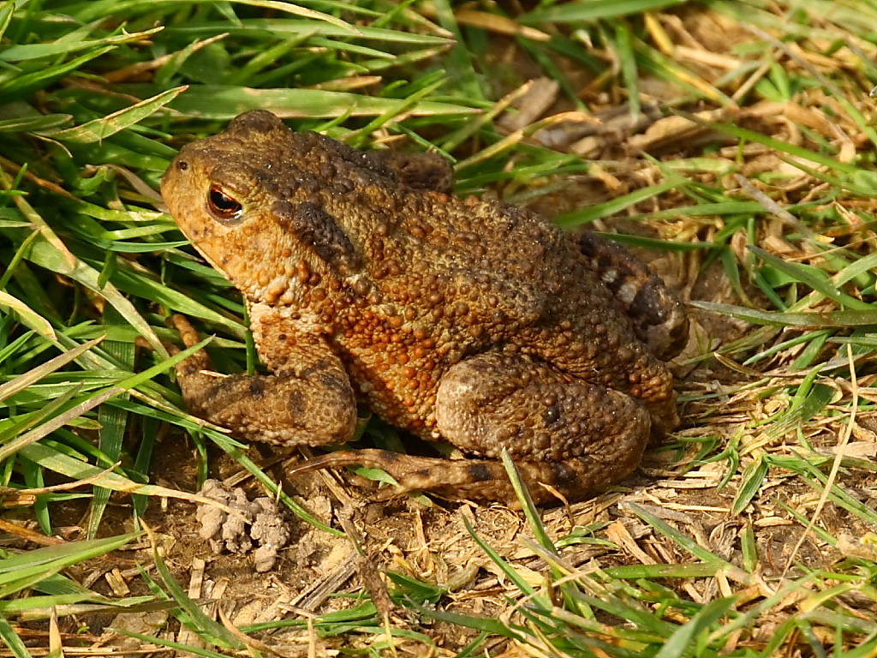
Questions?

